Slide 1
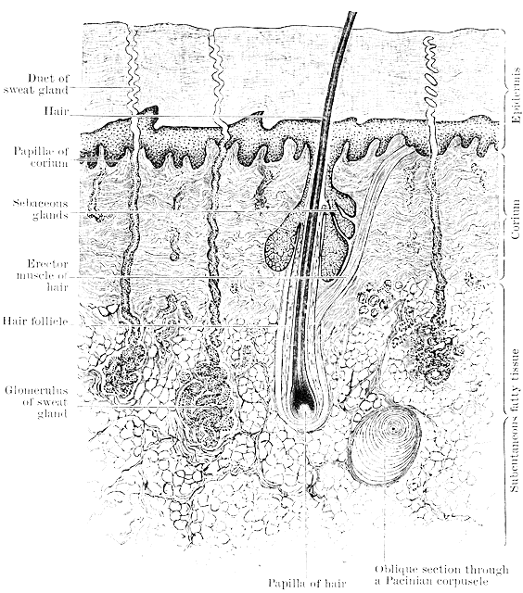
The Integumentary System - the dermis
T. Rick

Slide 2
How come your hair keeps growing back? Where do our hair and nails come from?

Slide 3
Student objectives
Define the dermis and the tissue of which it is made.
Describe the functions of hair and nails.
Name the cutaneous senses and explain their importance.
Describe functions of the secretions of sebaceous glands and the eccrine sweat glands.
Describe how the arterioles in the dermis respond to heat, cold, and stress.

Slide 4
Dermis
The _________ is made of irregular type of ________________tissue.
The dermis contains accessory skin structures: hair and nail follicles, sensory receptors, and several types of glands.
________________ means that the fibers are not parallel, but run in all directions.
Fibroblasts produce both ________________ and ________________ fibers.
________________ and ________________ are two characteristics of the dermis.

Slide 5
Papillary Junction
The uneven junction of the dermis with the epidermis is called ________________.
Capillaries are abundant here to nourish the dermis and epidermis.

Slide 6
Hair Follicles
________________ are made of epidermal tissue, and the growth process of hair is very similar to the growth of the epidermis.
At the base is the ________________, which contains cells called the matrix, where mitosis takes place.
New cells produce keratin, get their color from melanin, then die and become part of the ________________, which is pushed towards the surface of the skin.
Hair growth averages 8-10 mm/month.

Slide 7
Functions of human hair
Eyelashes and eyebrows help to keep _____ and ________________ out of eyes.
Hairs in nostrils help to keep _____ out of nasal cavities.
Hair of the scalp provides ________ from cold on the head.
Attached to each hair follicle is a small, smooth muscle called ________________. It gives us ‘goosebumps’.

Slide 8
Nail Follicles
At the end of fingers and toes, nail follicles produce nails just as hair follicles produce hair.
Mitosis takes place in the ________________ at the base of the nail, and the new cells produce keratin and then die.
The nail itself consists of ________________ dead cells, the flat nail bed is living epidermis and dermis.
Fingernails grow about 3mm/month.

Slide 9
Functions of nails
Nails ________________ the end of fingers and toes from mechanical injury and gives the fingers greater ability to pick up small objects.
Fingernails are also good for ________________ :
Arthropod parasite, mosquito, tick, or flea.

Slide 10
Receptors
Receptors and sensations provide the central nervous system with information about the external environment and its effects on the skin.
Most sensory receptors for the cutaneous senses are found in the dermis.
Cutaneous senses are touch, heat, cold, and pain.
________________ feel pain, heat, or cold.
________________ feel touch and pressure.

Slide 11
Sensitivity
The ________________ of an area of skin is determined by how many receptors are present.
Fingertips are very sensitive to touch because there are many ________________.

Slide 12
Glands
Glands are made of epithelial tissue:
________________
________________

Slide 13
Sebaceous Glands
The ducts of ________________ open into hair follicles or directly to the skin surface.
They secrete ________, a lipid substance (oil):
Inhibits the growth of bacteria on the skin surface
Prevents drying of skin and hair.
Adolescents may have problems of ___________ sebaceous glands. Too much sebum traps bacteria in hair follicles and create small infections.

Slide 14
Sweat Glands
There are two types of sweat glands:
________________ : most numerous in underarm and genital areas. Sensitive to stress and emotional situations.
________________ : all over body, but numerous on forehead, upper lip, palms, and soles. Secretory portion of these glands is a coiled tube in the dermis. The duct to the skin’s surface is called a _______.

Slide 15
Sweat
The sweat produced by eccrine glands is important in the maintenance of normal body ________________.
A great deal of heat can be can be lost in evaporation of relatively small amount of water.
Loss of too much body water in sweat may cause ________________.
________________ is also lost in sweat, as are small amounts or _______ (a nitrogenous waste product of amino acid metabolism).

Slide 16
Blood Vessels
Besides the capillaries in the dermis, arterioles are of great importance.
________________ are small arteries, and the smooth muscle in their walls permits them to constrict (close) or dilate (open) to maintain body temperature.
When arterioles dilate (________________), blood flow ________________ in dermis and releases heat through skin.
When arterioles contract (________________), blood flow is ________________ keeping heat inside body.
Vasoconstriction may occur during stressful situations, because of ‘________________’.

Slide 17
Review
Define the dermis and the tissue of which it is made.
Where, on the body, does human hair have important functions? Describe these functions.
Describe the functions of nails.
Name the cutaneous senses and explain their importance.
Explain the functions of sebum and cerumen.
How do the arterioles in the dermis respond to heat, cold, and stress?

