Slide 1
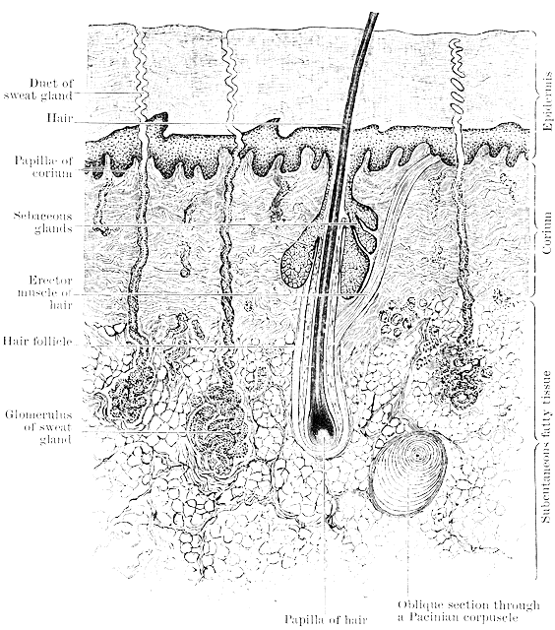
The Integumentary System - the anatomy of skin
T. Rick

Slide 2
Student objectives
Learn the anatomy of the skin and its main organization.
Label the important parts of the skin and appendages.

Slide 3
The Integumentary System
The integumentary system consists of the skin, its accessory structures such as hair and sweat glands, and the subcutaneous tissue below the skin.
The skin is made of several different tissue types and is considered an organ.

Slide 10
Review questions
What are the key functions of the skin?
Name the parts of the integumentary system.

