Slide 1
Rickets
By Suriyod#1 612, Wis#6 612, Pitchaya#4 612

Slide 2
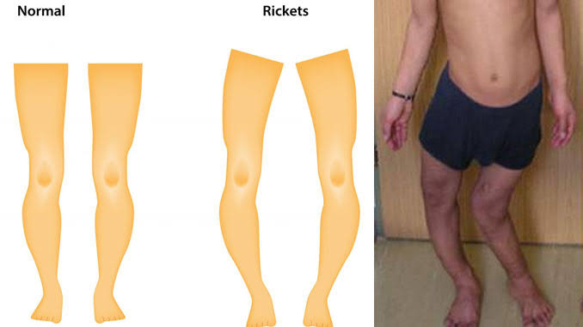
What is Rickets
Is a condition that results in weak or soft bones in children which caused by lack of vitamin D, calcium, or phosphate.

Slide 3
Who is at risk for developing rickets?
Age
Common in children who are between 6-36 months old
Diet
Eat a vegetarian diet that doesn’t include fish, eggs, or milk
Infants who are only fed breast milk can become deficient in vitamin D as well.
Skin color
Children of African, Middle Eastern, Asia are high risk for rickets because they have dark skin
Geographic location
Live in the area with little sunlight (vitamin D absorption)
Genes
Disorder can passed down through the genes(hereditary rickets)

Slide 4
Vitamin D
Helps the body control calcium and phosphate levels. If these minerals in our body become too low, the body may produce hormones that cause calcium and phosphate to released from the bone.
Absorbed from food or produced by skin when exposed to sunlight .
Lack of Vitamin D production when:
- Live in climate with little exposure to sunlight
- Must stay indoors
- Work indoors during the daylight hours

Slide 5
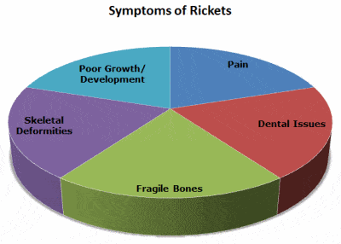
Symptoms
Include –
pain or tenderness in bone
Stunted growth
Muscle cramps
Passing a lot of urine
Feeling thirsty
Dizziness and headaches

Slide 6
Treatment
Focuses on replacing missing vitamin or mineral in our body
Taking daily calcium and vitamin D supplements
Having Vitamin D injection each year( only for the children that can’t take supplement)
Expectation after treatment
After increase vitamin D, calcium, and phosphate levels will help correct the disorder
Most of children will see improvement in about 1 week.
The weakness of the skeleton can become permanent if the disorder isn’t treated during a child’s growth period.

Slide 7
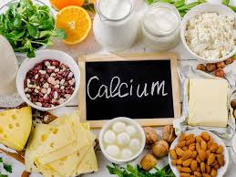
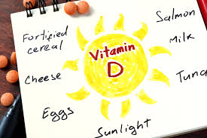
Prevention
Increase Vitamin D and calcium level by
Eating more food with calcium & vitamin D
Get more sunlight
Take Vitamin D supplement
Reduce intake of caffeine, soft drinks and alcohol (inhibit calcium absorption).

Slide 8
Visual
https://youtu.be/HMYSys-T3Rs

Slide 9
Thank you

