Slide 1
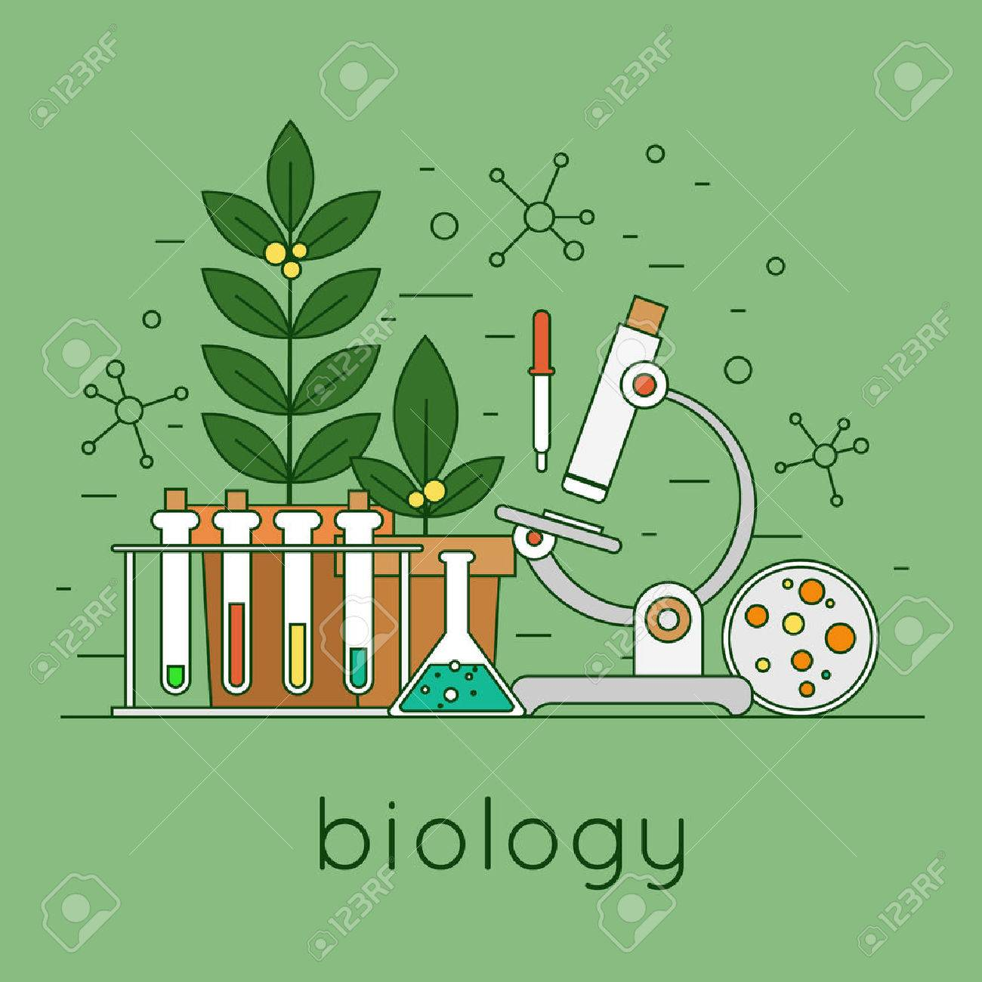
The Science of Life
Themes in Biology

Slide 2
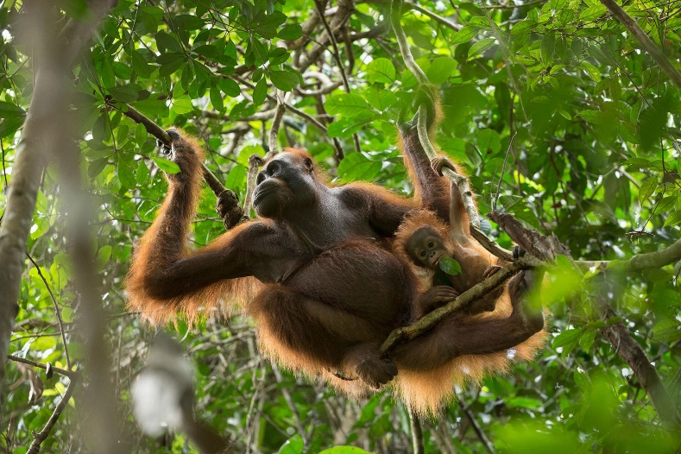
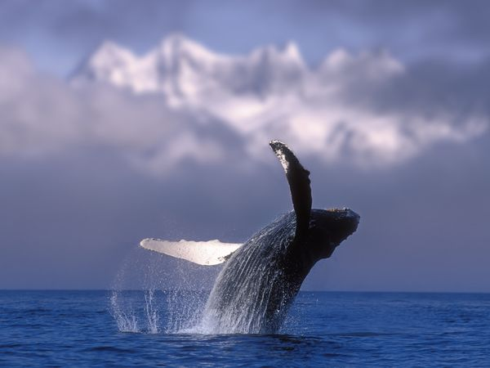
Themes in Biology

Slide 3
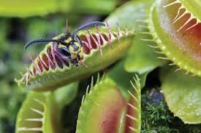
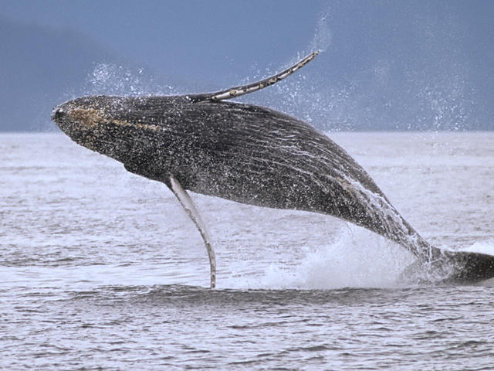
1. Diversity of Life

Slide 4
1. Unity of Life

Slide 5
Tree of Life

Slide 6
2. Interdependence of Organisms

Slide 7
3. Evolution of Life

