Slide 1
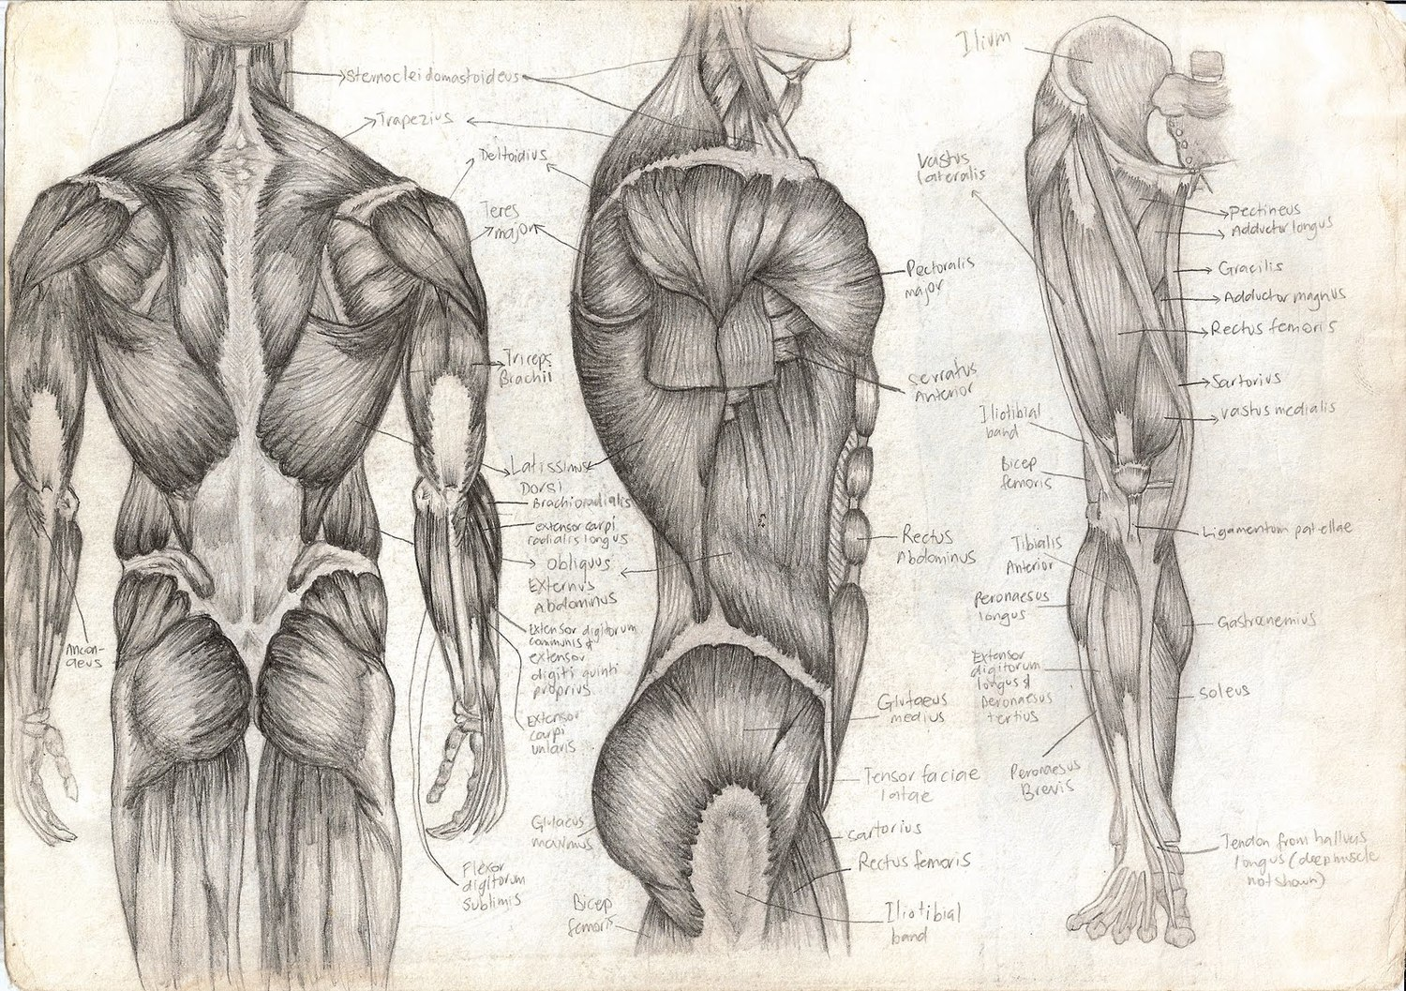
Energy Sources for Contraction
T. Rick

Slide 2
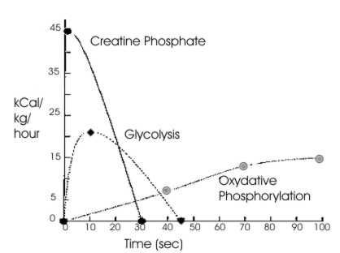
Energy sources
The direct source for muscle fibers is _____ (Adenosine Triphosphate).
The _____________ energy sources are _____________and _____________.

Slide 3
Creatine Phosphate
Creatine phosphate is an energy-transferring molecule. When it is _____________(by an enzyme) to _____________, _____________, and _____________. The energy is used to synthesize more ATP.
Most _____________ formed is used to resynthesize creatine phosphate, but some is converted to _____________, a _____________ waste that is excreted by the _____________.

Slide 4
Glycogen
The most abundant energy source in muscle fibers is _____________.
Glycogen is needed to provide energy for _____________ contractions (more than a few seconds).
It is broken down into the glucose molecules of which it is made. It is then further broken down in the process of cell respiration to produce ATP.
______ + ______ -> ______ + ______ + ______ + ______

Slide 5
Glucose + O2 -> CO2 + H2O + ATP + heat
The ______ produced will contribute to body _________ and is _________ is strenuous, will increase body temperature.
The water becomes part of _________ water, and the carbon dioxide will be _________.

Slide 6
Hemoglobin and Myoglobin
______________ in red blood cells continuously carry oxygen to the muscle fibers.
______________ is a ______________ in muscle fibers that stores some oxygen within the muscle cells.
Myoglobin and hemoglobin contain ________, which enables them to bond to oxygen.
During intense exercise, oxygen in myoglobin is ___________ used up and normal circulation isn’t fast enough to permit cell ______________.
When muscle fibers run out of oxygen, this is called ______________. And glycose might be converted to an intermediate molecule called ______________, which causes ______________.

Slide 7
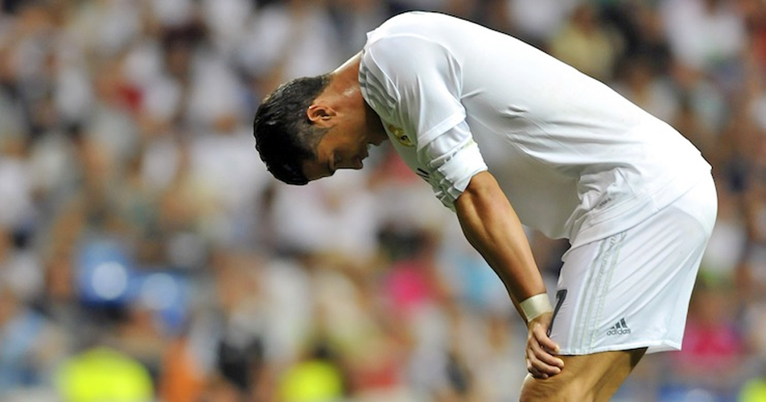
A state of fatigue
______________ cannot contract efficiently, and contractions become ______________.
Oxygen debt means we _____ the body some oxygen, because the livers is using ATP to convert lactic acid to _______________, a simple ______________.
This is why we remain having a high ______________ and ______________ after intense exercise. This is ___________________________.

