Slide 1
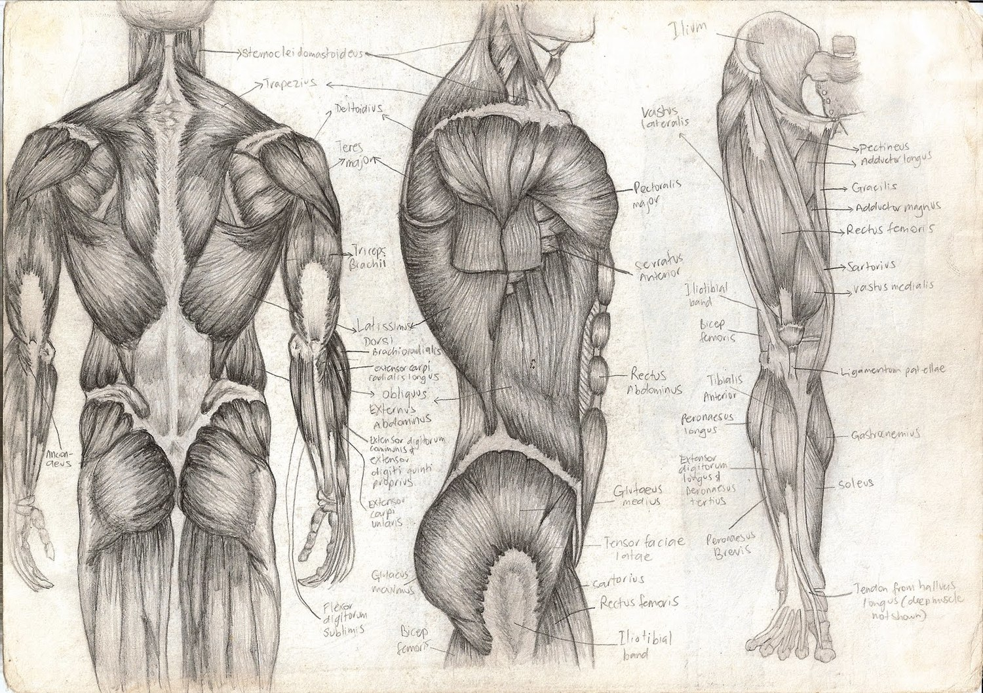
Intro to The Muscular System
T. Rick

Slide 2
The muscular system intro
There are more than ___________in the human body.
The primary function of _______________ is to _____ the skeleton.
The muscle _______________ produce _____, which contributes to the maintenance of _______________.
The ___________, ___________, and ___________ systems are involved in ___________.
3 types of muscles: ___________, ___________, and ___________ muscles.

Slide 3
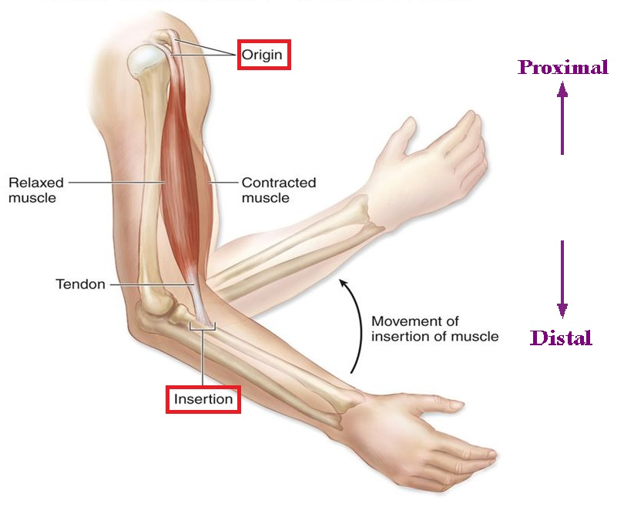
Muscle structure
All muscles are specialized for ___________.
Skeletal muscle is made of thousands of individual cells; ___________.
Muscle has usually 2 tendons; __________________.
Most muscles are ________ firmly to bones by ___________.
Fibrous connective tissue
Merges with fascia and connects to __________

Slide 4
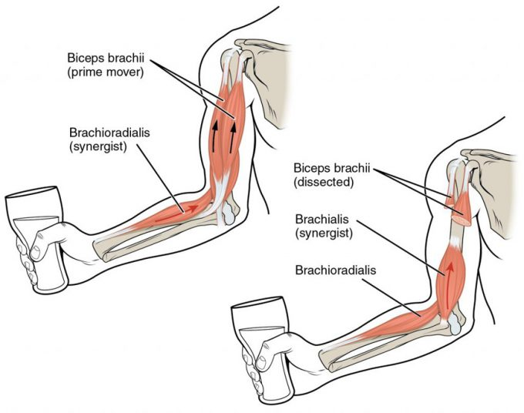
Muscle arrangements
Muscles are arranged around the bod to bring about variety of __________.
__________
__________

Slide 5
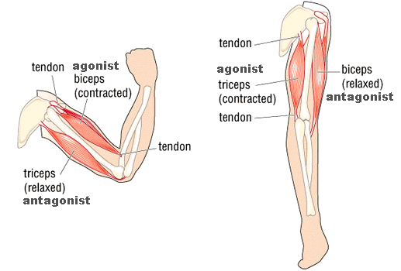
Antagonistic muscles
__________________are muscles that have opposing functions.
Joints that are capable of a variety of movements have several antagonists.
______________are often recommended to preserve muscle ____________________.

Slide 6
Synergistic muscles
____________________are muscles with the same function.
The ____________is the muscle that does most of the __________.
__________ can also __________ or steady a joint to make more precise __________ possible.

Slide 7
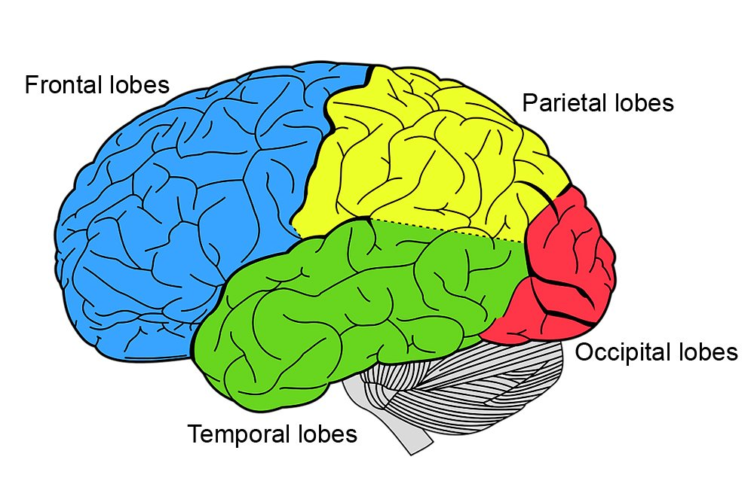
Role of the Brain
The ___________ of muscles depend on the brain.
_______________ come from the __________of the __________.
The motor areas of the frontal lobes generate ______________ impulses that travel along motor nerves to ____________.
Some muscles must _______ while other _______.
___________ is unconscious and is regulated by cerebellum.

