Slide 1
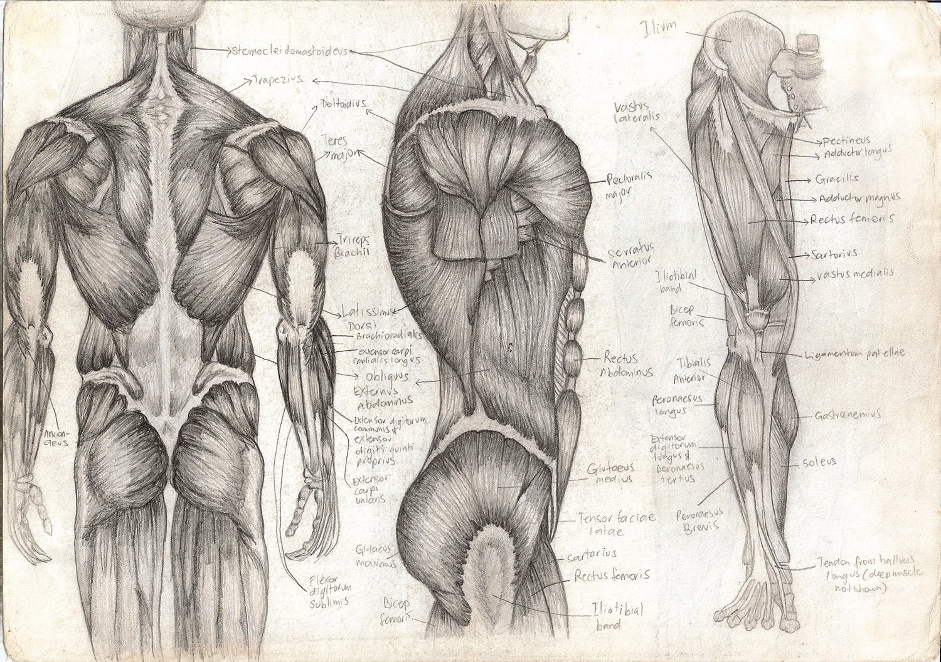
Muscle Fiber – Microscopic Structure
T. Rick

Slide 2
Objectives
Describe the neuromuscular junction and state the function of each part.
Describe the structure of the sarcomere.
Explain the following terms of ions and charges: polarization, depolarization, and repolarization.

Slide 3
Muscle Fiber
We will now look at a muscle fiber, keep in mind that there are thousands of these ______________in one muscle.
Each muscle fibers has ______________ which are cylinders within the muscle fiber.
Each Myofibril has ______________ of individual ______________ units called ______________.

Slide 4
Neuromuscular Junction

Slide 5
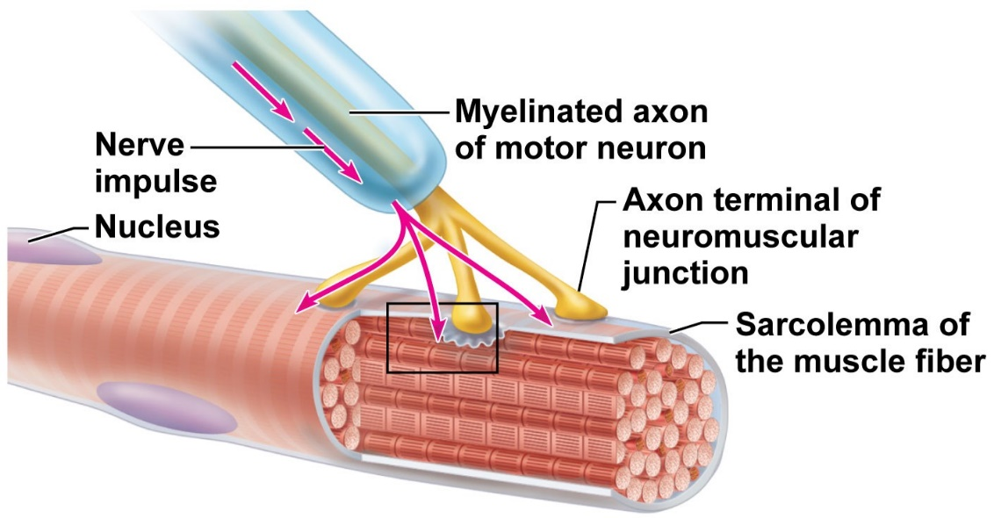
Neuromuscular Junction
Each muscle fiber has its own motor nerve ending: the ______________ ______________.
The ______________ is the ______________ tip of the motor neuron; it contains sacs of the neuron transmitter ______________ (ACh).
The membrane of the muscle fiber is the ______________, which contains receptor sites for acetylcholine, and an ______________ called ______________.
The ______________ (or synaptic cleft) is the __________________ the axon terminal and the sarcolemma.

Slide 6
Sarcomeres

Slide 7
Sarcomere
Filaments of the protein ______________ are in the center of the sarcomere.
Myosin filaments are attached to the z line by the protein ______________.
Filaments of the protein ______________ are at the ends, attached to the ______________.
Myosin and actin are the ______________ ______________ of a muscle fiber.
______________ and ______________ are proteins that prevent the sliding of actin and myosin when the muscle is relaxed.

Slide 8
Sarcoplasmic Reticulum
Surrounding the sarcomeres is the endoplasmic reticulum of muscle cells called ______________ ______________.
The sarcoplasmic reticulum is the reservoir for ______________, which are essential for the contraction process.

Slide 9
The Sliding Filament Mechanism
All of the previous parts discussed are involved in the contraction process.
Contraction begins when a ______________ arrives at the axon terminal and stimulates the release of ______________.
Acetylcholine generates electrical changes (____________________) at the sarcolemma of the muscle fiber.
These electrical changes initiate a sequence of events within the muscle fiber that is called the ____________________________ of muscle contraction.

Slide 10
Sarcolemma – Polarization Resting potential
When a muscle fiber is relaxed, the sarcolemma is ______________ (has a resting potential).
During polarization, the outside of the sarcolemma has a positive charge relative to the inside.
The sodium ions (NA+) outside tend do diffuse into the cell and the ______________ transfers them back out.
The Potassium ions (K+) tend to diffuse outside, and ______________ returns them inside.
These pumps are ______________ transport mechanisms, which require ______________.

Slide 11
Sarcolemma – Depolarization Action Potential
When a nerve impulse arrives, acetylcholine bonds to acetylcholine receptors on the sarcolemma.
Acetylcholine makes the sarcolemma very permeable to Sodium ions, which rush into the cell.
This makes the inside od the sarcolemma ______________ relative to the outside (______________).
The reversal of charges now spreads all across the entire sarcolemma.
______________ at the sarcolemma inactivates Acetylcholine.

Slide 12
Sarcolemma – Repolarization Action potential
Sarcolemma becomes very permeable to ______________, which rush out of the cell.
Restoration of charges on the sarcolemma: (+) outside and (-) inside.
The sodium and potassium pumps return Sodium ions ________ and Potassium ions ________.
The muscle fiber is now able to respond to acetylcholine released by another nerve impulse arriving at the axon terminal.

