Slide 1
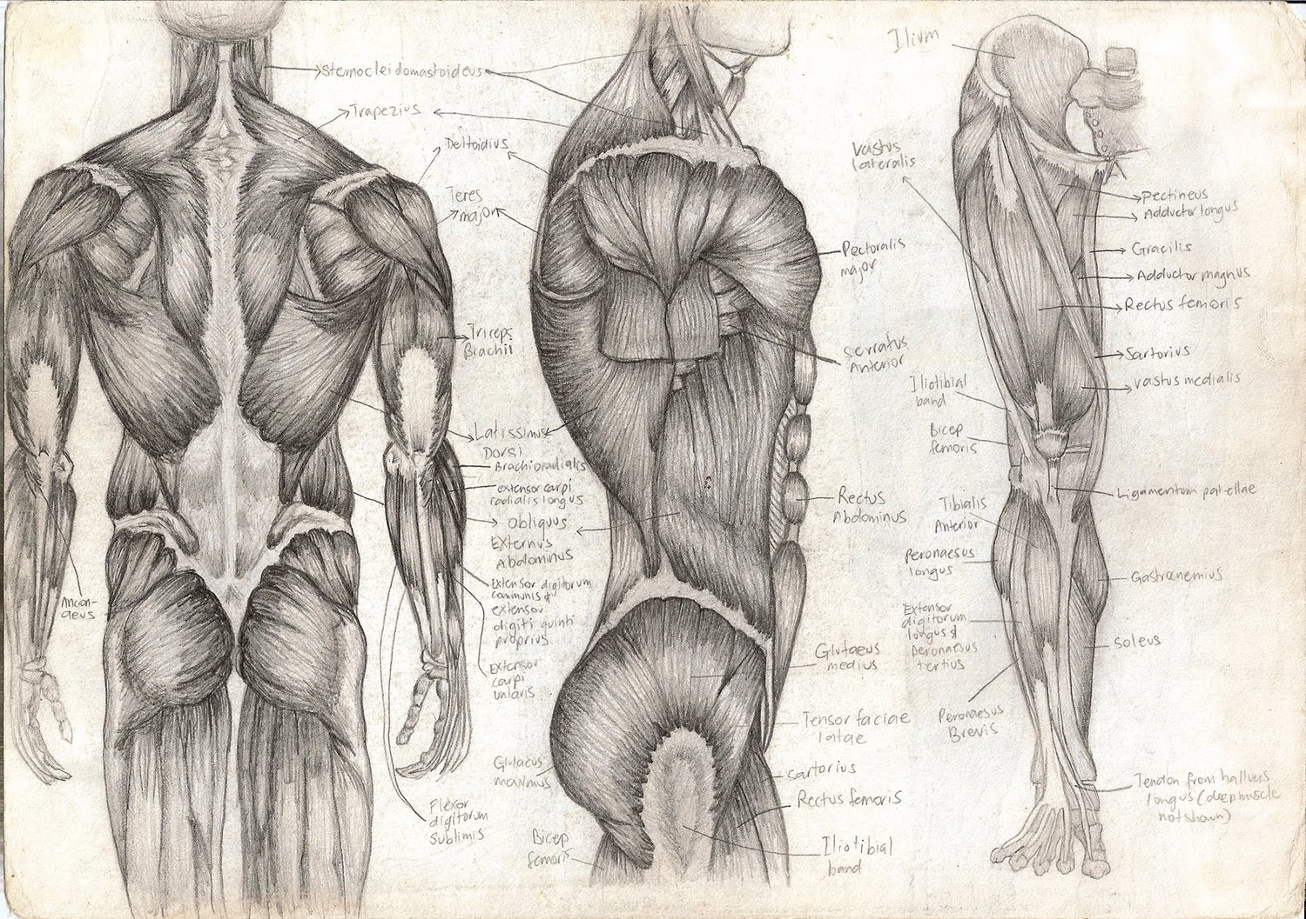
Muscle Tone and Muscle Sense
T. Rick

Slide 2
Muscle Tone
Most of our __________ are in a state of slight ______________; this is called ______________.
It is important for __________ to keep an ____________________.
Only a few __________ are __________ to keep muscle tone.
Alternate __________ contract to avoid the muscle as a whole become __________.
Muscle tone is regulated by the __________ of the brain.
Muscle fibers need the energy of ____________________.

Slide 3
Exercise
Good muscle tone improves __________.
When muscle fibers are slightly __________, they can react more __________ if and when ______________ is necessary.
Muscles with poor tone are usually __________ and flabby, but __________ will improve muscle tone.
There are 2 general types of exercise:
__________ exercise
__________ exercise

Slide 4
Isotonic exercise
In __________ __________, muscles contract and bring about __________.
Isotonic exercise improves muscle __________, muscle __________, and muscle __________.
It also improves __________ and __________ efficiency.
If done __________ or longer, exercise may be called __________, because it __________ the heart and respiratory muscles as well.

Slide 5
Isotonic contractions
A __________ __________ is the __________ of a muscle as it exerts __________.
An __________ __________ is the __________ of a muscle as it still exerts __________.

Slide 6
Isometric exercise
__________ __________ involves contraction __________ __________.
This __________ will improve muscle __________ and muscle __________, but is not considered aerobic.
Many of our actions involve both __________ and __________ contractions.

Slide 7
Muscle sense
__________ __________ (proprioception) is the brain’s ability to know where our __________ are and what they are doing, without __________ looking at them.
Within muscles are receptors called __________ __________. The general function of all sensory receptors is to detect changes.
The impulses for muscle sense are integrated in the __________ lobes of the __________ (__________ muscle sense) and in the __________ (__________ muscle sense) to be used to promote coordination.

