Slide 1
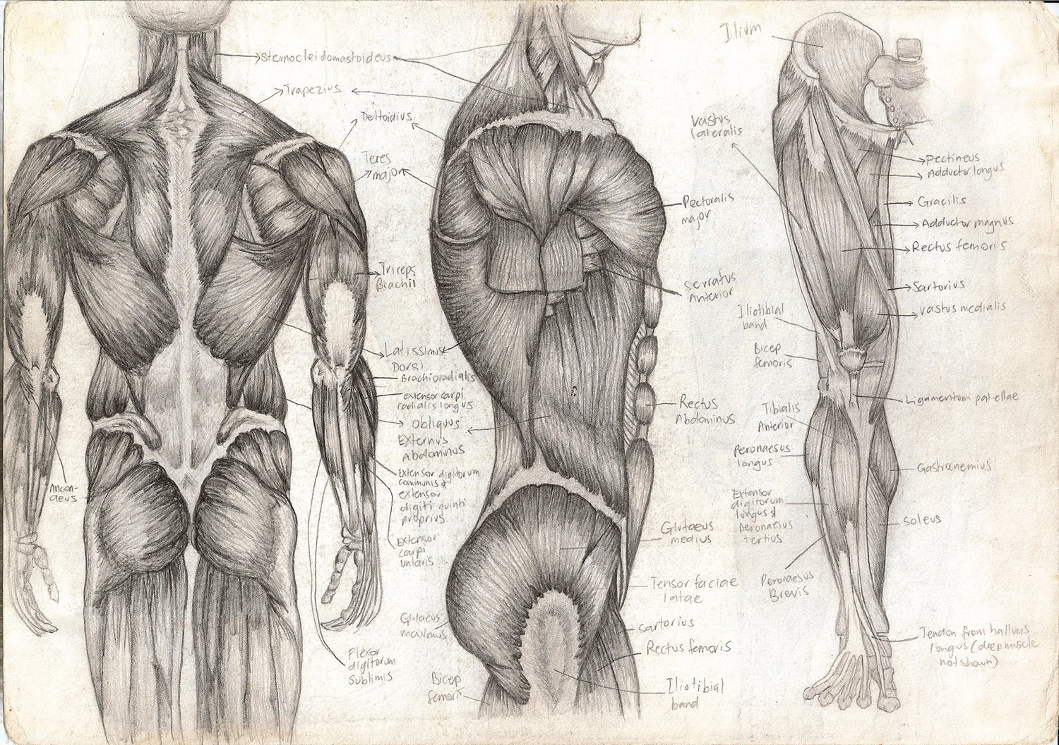
Sliding Filament Mechanism
T. Rick

Slide 2
Objectives
Describe the sliding filament mechanism of muscle contraction.
Describe some of the body’s muscle impairments.

Slide 3
The Sliding Filament Mechanism
A nerve impulse causes ______________ of a ______________, and this ______________ change enables the ______________ filaments to pull the ______________ filaments toward the center of the sarcomere, making the ______________ shorter.

Slide 4
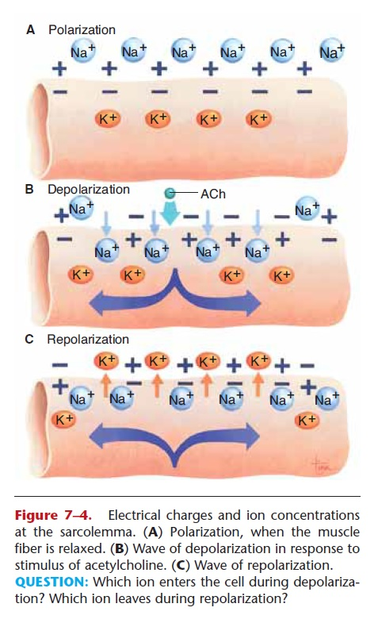
Acetylcholine
A nerve impulse arrives at the axon terminal; ______________ is released and diffuses across the ______________.
Acetylcholine makes the sarcolemma more permeable to ______________, which rush into the cell.
The Sarcolemma ______________, becoming ______________ outside and ______________ inside.
All of the sarcomeres in a muscle fiber ______________ – the entire muscle fiber ______________.

Slide 5
Depolarization
______________ stimulates the release of Calcium ions from the ______________. Calcium ions bond to the ______________ complex. Which shift away from the actin filaments.
Myosin splits ATP to release its energy; bridges on the myosin attach to the actin filaments and pull them toward the center of the sarcomere, thus making the sarcomere shorter.

Slide 6
Repolarization
The Sarcolemma ______________ : ______________ ions leave the cell, restoring a positive charge outside and a negative charge inside. The pumps return ______________ ions outside and ______________ ions inside.

Slide 7
Cholinesterase
______________ in the sarcolemma ______________ ______________.
Subsequent nerve impulses will prolong contraction (more acetylcholine is released).
When there are no further impulses, the muscle fiber will ______________ and return to its original state.

Slide 8
Tetanus
A single muscle fiber contraction in response to a single nerve impulse is called a ______________.
Nerve impulses arrive in a continuous stream and produce a sustained contraction called a ______________.

Slide 9
Impairment of muscle contraction
Loss of nerve impulses to muscle fibers, which occur when nerves or the spinal cord are severed.
A ______________ occurs in the frontal lobes of the cerebrum.
Without nerve impulses, skeletal muscles become ______________, unable to contract.
Paralyzed muscles eventually ______________; becoming smaller from lack of use.

