Slide 1
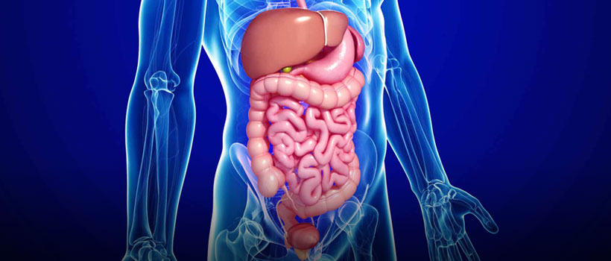
Digestive System
T. Rick

Slide 2
How, then, are animals able to digest food without digesting their own cells and tissues?
If digestive systems hydrolyze the same biological materials (Carbohydrates, Fats, and Proteins) that make up the bodies of human’s themselves.

Slide 3
Alimentary Canal
In most animal species, at least some hydrolysis occurs by extracellular digestion, the breakdown of food in compartments that are continuous with the outside of the animal’s body.
Alimentary Canal: The complete digestive system from mouth to rectum
Gastrointestinal Tract: A long tube that winds throughout the body to the anus

Slide 4
Stages of Food Processing
Breaking down food into molecules that your body can use:
Ingestion of food,
mechanical and chemical digestion,
absorption of nutrients,
elimination of waste

Slide 5
Oral Cavity
Ingestion and the initial steps of digestion occur in the mouth, or oral cavity.
Teeth
Saliva
Tongue

Slide 6
Teeth
Mechanical digestion begins as teeth of various shapes cut, mash, and grind food, making the food easier to swallow and increasing its surface area.

Slide 7
Saliva
Saliva initiates chemical digestion while also protecting the oral cavity.
The enzyme amylase, found in saliva, hydrolyzes starch and glycogen into smaller polysaccharides and the disaccharide maltose.
Mucus in saliva protects the lining of the mouth from abrasion, lubricates food, include buffers, and includes antimicrobial agents.

Slide 8
Tongue
The tongue aids digestive processes by evaluating ingested material and then enabling its further passage.
The tongue helps shape food into a ball called a bolus.
During swallowing, the tongue provides further help, pushing the bolus to the back of the oral cavity and into the pharynx.

Slide 9
Pharynx and Esophagus
The pharynx, or throat region, opens to two passageways: the esophagus and the trachea (windpipe).
The esophagus connects to the stomach.
A flap of cartilage called the epiglottis covers the glottis—the vocal cords and the opening between them.

Slide 10
Peristalsis Waves
Peristalsis Waves: Rings of muscle contract and relax to move food through the digestive system

Slide 12
Stomach: mechanical and chemical digestion of food
Sphincter muscles are found at each end of the stomach
The stomach stores food and begins digestion of proteins.
The stomach secretes a digestive fluid called gastric juice and mixes this secretion with the food through a churning action.
This mixture of ingested food and digestive juice is called chyme.

Slide 13
Stomach: mechanical digestion
Three layers of muscle:
Circular layer
Longitudinal layer
Diagonal layer
Churn the contents for about 4 hours

Slide 14
Stomach: chemical digestion

Slide 15
Liver
Storing glucose as glycogen
Making proteins
Breaking down toxic substances
Secretes bile (breaks fat globules into small droplets)

Slide 16
Gallbladder
Bile is stored and concentrated in the gallbladder.

Slide 17
Pancreas
The Pancreas serves 2 roles:
Produce sodium bicarbonate
Neutralizes stomach acid
Produce enzymes that break down carbohydrates, proteins, and lipids:
Amylases (polysaccharides -> maltose and other disaccharides)
Proteases (polypeptides -> smaller polypeptides)
Lipases (fat droplets -> glycerol, fatty acids, monoglycerides)

Slide 18
Small Intestine
Over 6 m long in humans, the small intestine is the alimentary canal’s longest compartment.
The first 25 cm or so of the small intestine forms the duodenum.
Here chyme mixes with digestive juices from the pancreas, liver, and gallbladder, as well as from gland cells of the intestinal wall itself.
The other parts are called jejunum and ileum.

Slide 19
Digestion in Small Intestine
Enzymes from epithelium tissue break down food even more:
Disaccharides -> monosaccharides
Small peptides -> amino acids

Slide 20
Absorption in Small Intestine
Millions of fingerlike projections (villi) create huge surface area.
Cells covering villi have extensions on cell membranes (microvilli).
Blood and lymph notes absorb amino acids, monosaccharides, glycerol, and fatty acids.

Slide 21
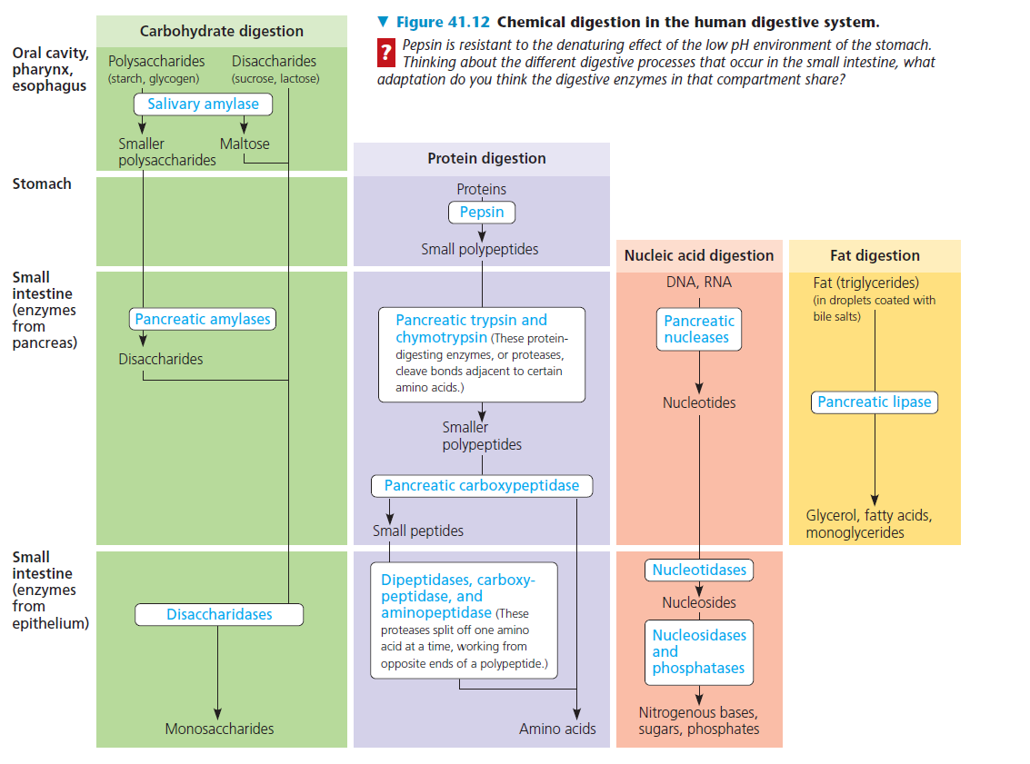

Slide 22
Large Intestine or Colon
Large Intestine absorbs nutrients produced by bacteria and reminder of water
There are 4 major parts in the Large Intestine:
Ascending colon
Transverse colon
Descending Colon
Sigmoid colon
Appendix: attached to beginning of ascending colon

Slide 23
Twitter fails

