Slide 1
Kwashiorkor
Presented by
Siwakorn Chanchalotorn 611 #4
Nirawit Arayapipatkul 611 #14
Kritapoj Sutanthavibul 612 #14

Slide 2
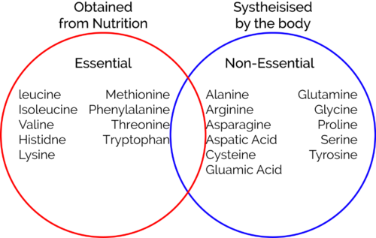

Slide 3
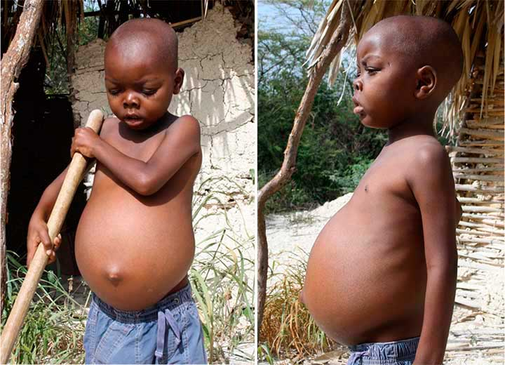
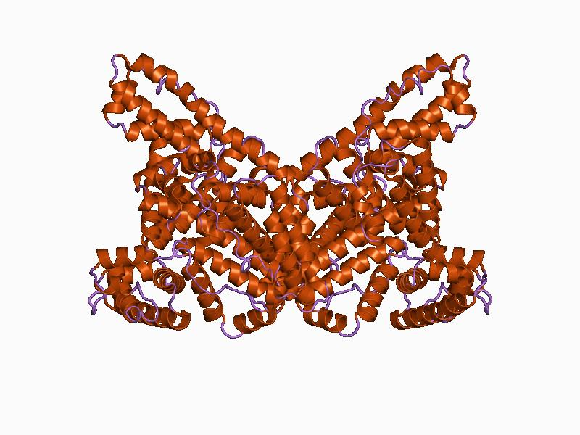
Causes of kwashiorkor
Starvation
Little protein intake
>>>No albumin

Slide 4
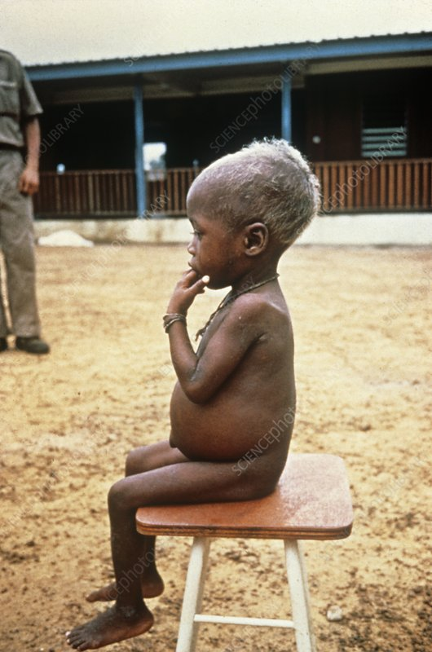
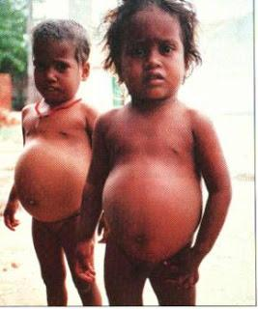
Fluid leaking
Albumin holds fluid
Common in plasma

Slide 5
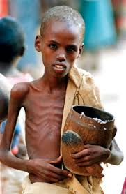
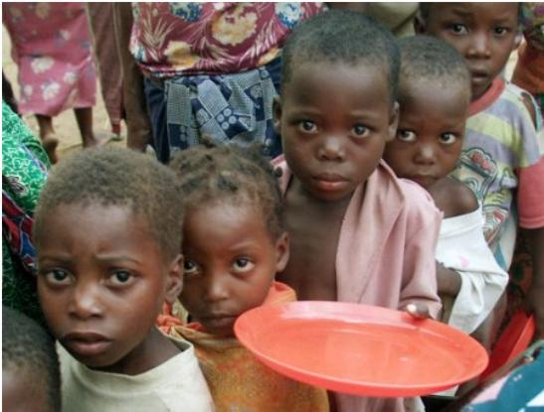
Starvation
1st Carbohydrates
2nd Lipid - Weeks
3rd Protein

Slide 6
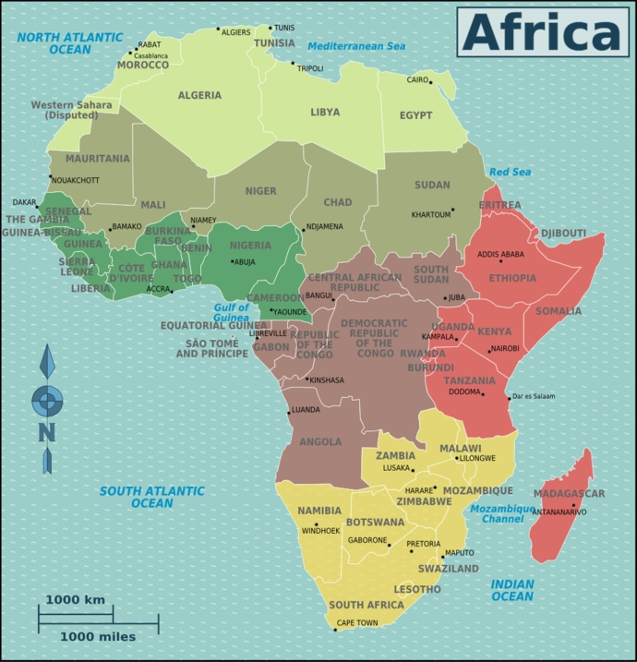
Epidemic
1930s first studied in africa
Most in africa
Famine

Slide 7
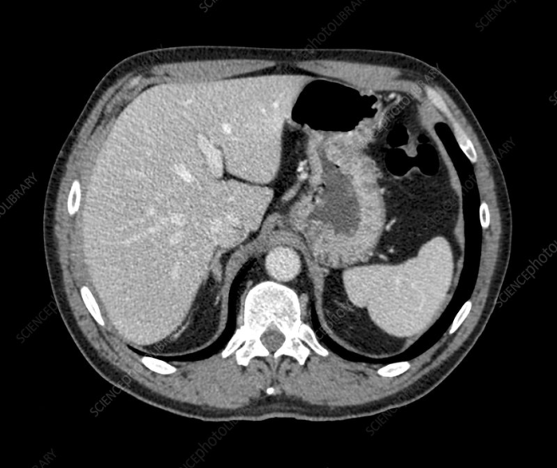
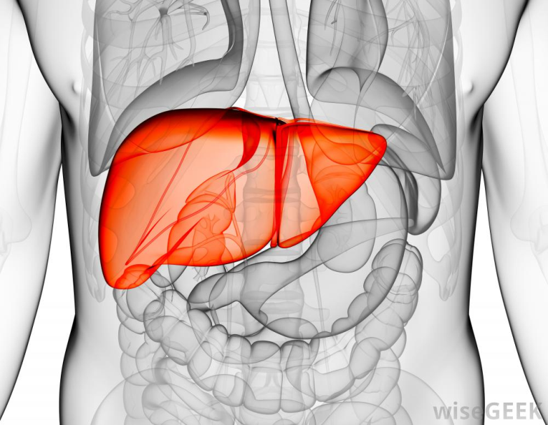
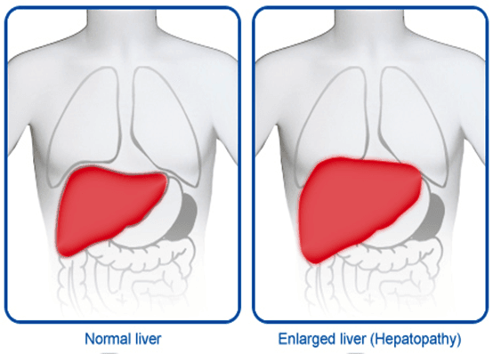
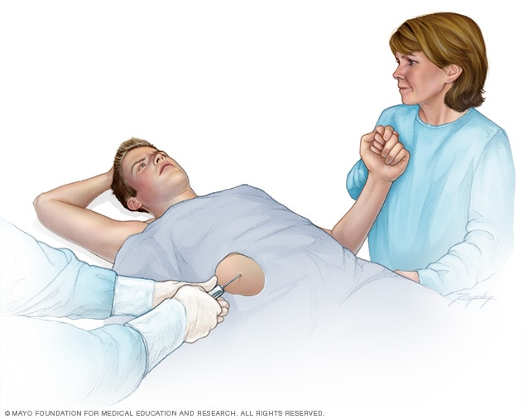
Kwashiorkor's Diagnosis
Checked for…
Enlarged liver
CT scan
liver biopsy

Slide 8
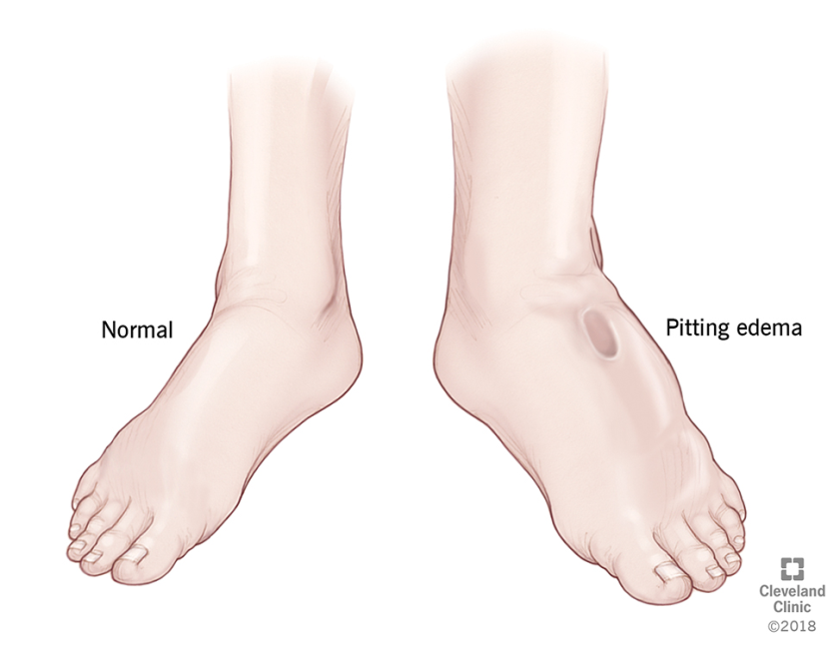
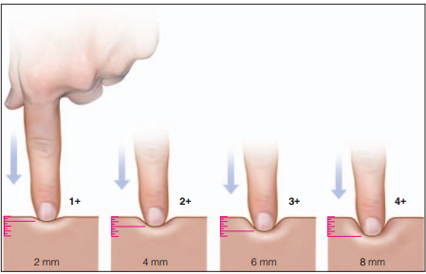
Swelling

Slide 9
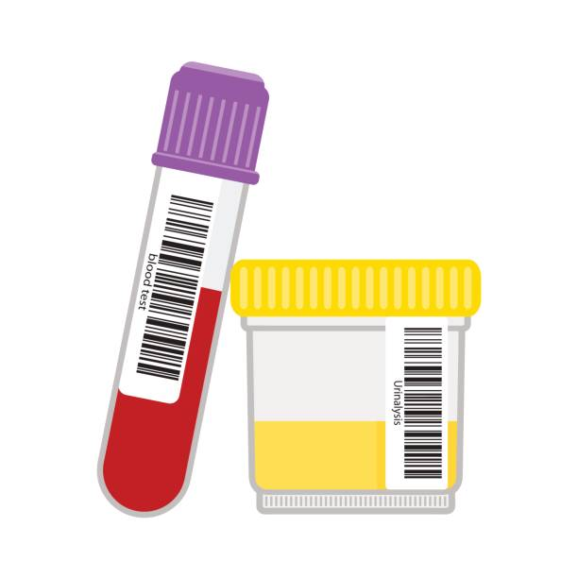
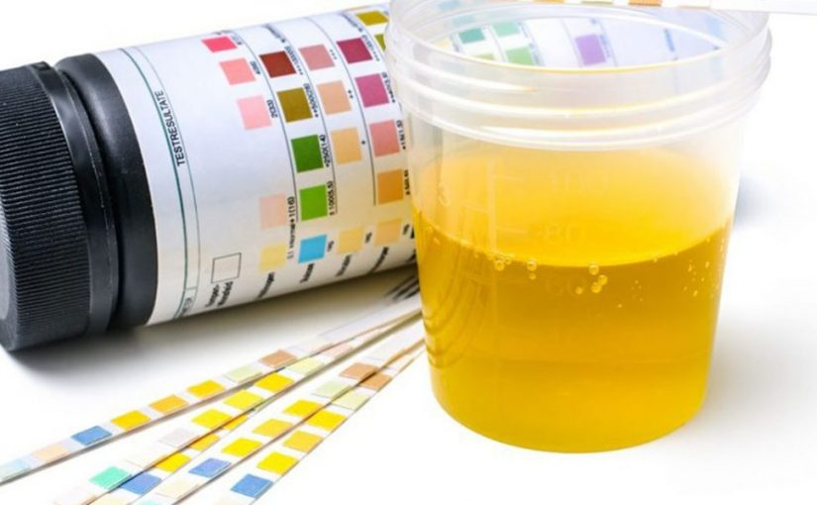
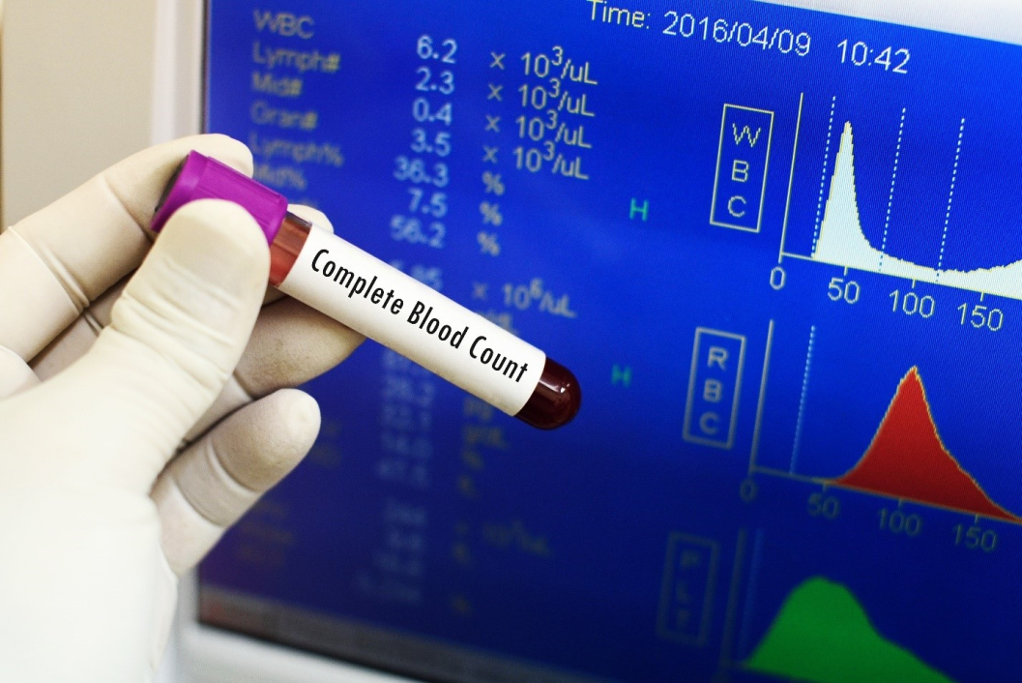
Next Step
Blood test
Arterial blood gas
Blood levels of creatinine
Blood levels of potassium
Blood urea nitrogen
Complete blood count
Urinary test

Slide 10
Signs
Swelling
starve
Hair thinning
Teeth

Slide 11
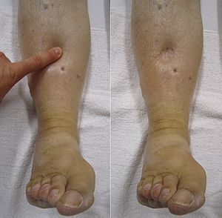
Symptoms
Edema
Other diseases
Anorexia development
Phys/mental development

Slide 13
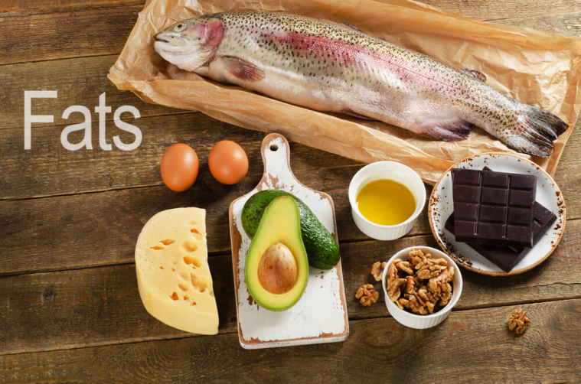
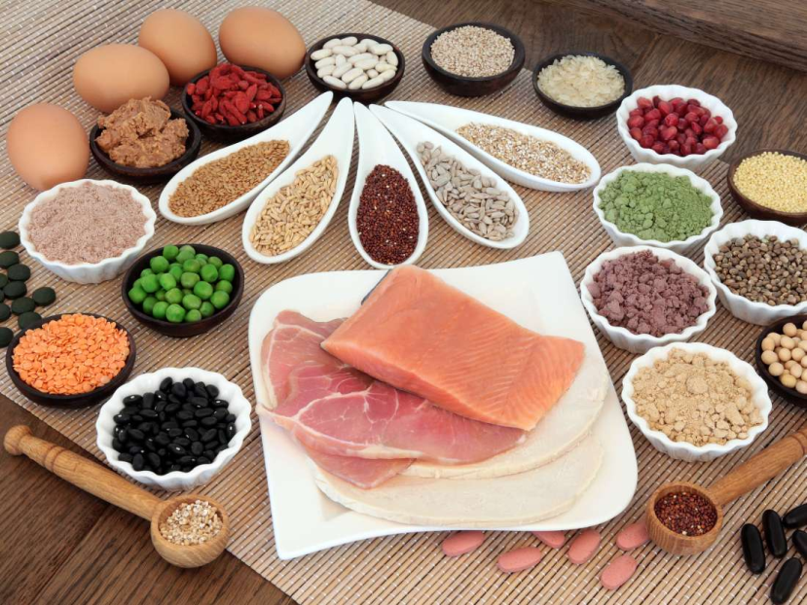
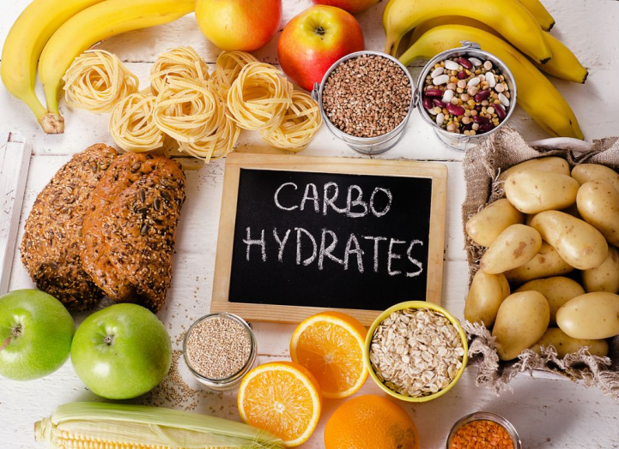
Treatment
Kwashiorkor is caused by a lack of protein in diet.
So…
It can be treated by eating more protein and calories

Slide 14
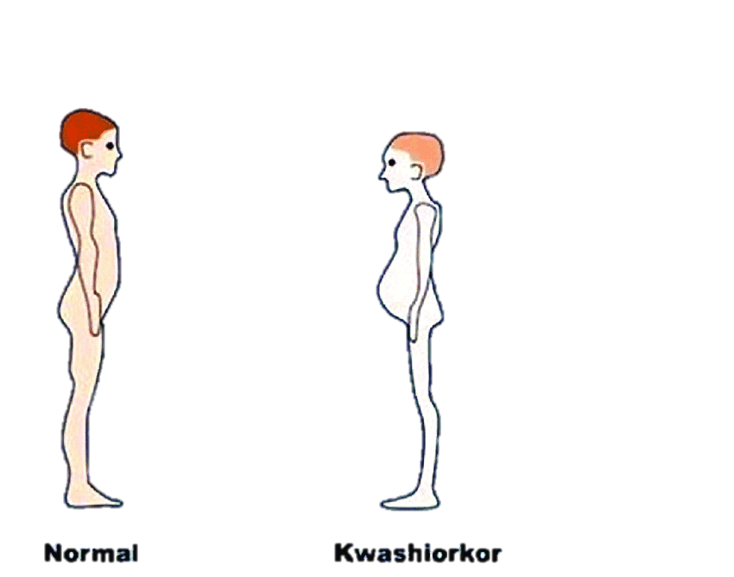
!!!But
Even with treatment
chance to never reach full growth

Slide 15
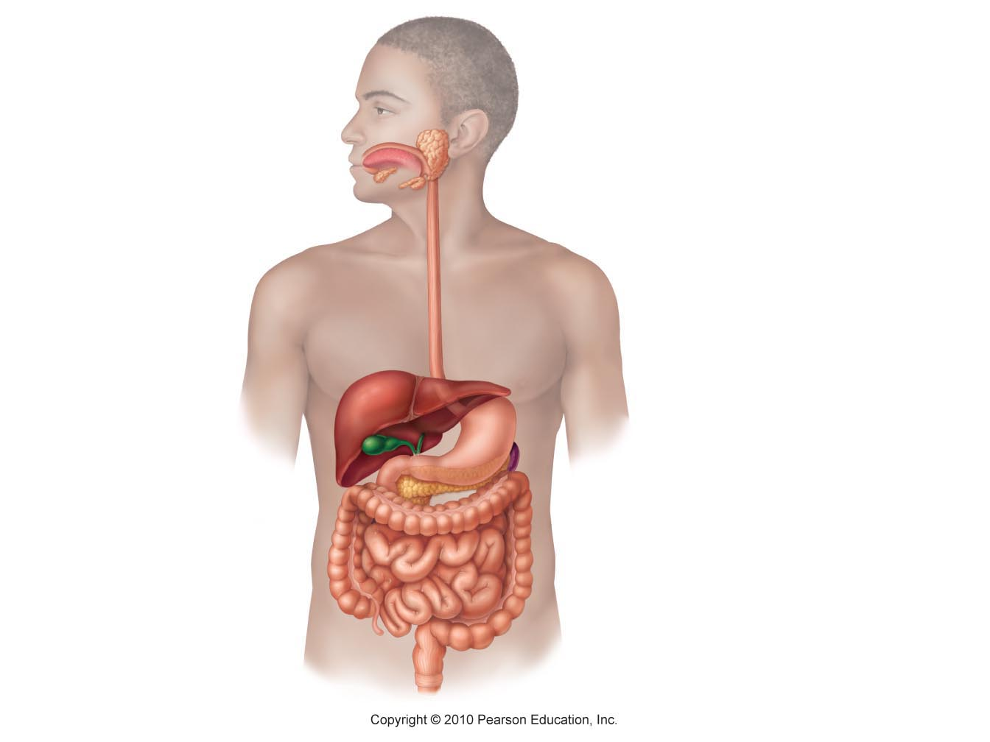

Slide 17
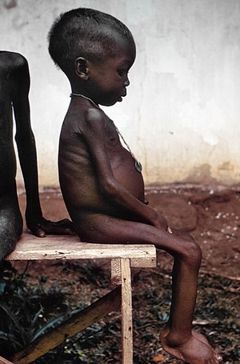
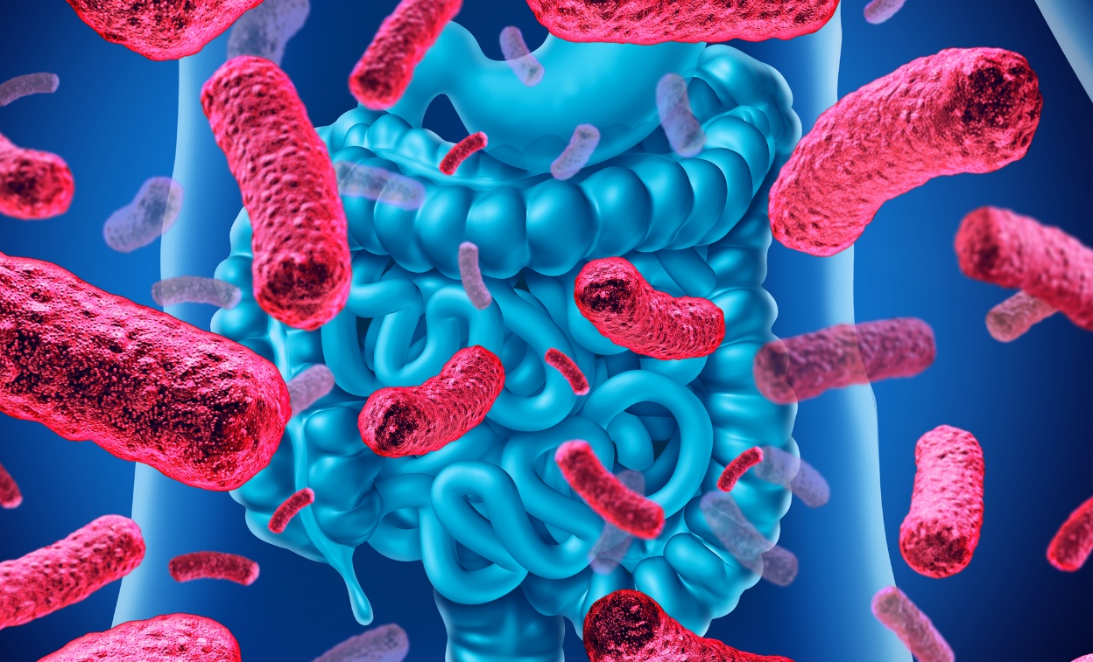

Slide 18
References
https://directorsblog.nih.gov/2013/02/05/who-knew-gut-bacteria-contribute-to-malnutrition/
https://dacemirror.sci-hub.tw/journal-article/b63bbb3c4a63901898824be6f0894652/netrasiri1955.pdf
https://www.healthline.com/health/kwashiorkor
https://www.healthline.com/symptom/liver-enlarged
https://www.ncbi.nlm.nih.gov/pmc/articles/PMC4476274/
http://www.thefringenews.com/what-is-non-alcoholic-fatty-liver-disease/
https://medsynapses.blogspot.com/2017/02/hepatolineal-syndrome.html
http://www.med-health.net/Edema-Grading.html
https://www.istockphoto.com/th/illustrations/urine-sample?assettype=image&sort=mostpopular&mediatype=illustration&phrase=urine%20sample
https://my.clevelandclinic.org/health/diseases/17937-enlarged-liver/diagnosis-and-tests
https://www.mayoclinic.org/diseases-conditions/enlarged-liver/diagnosis-treatment/drc-20372171
https://www.sciencephoto.com/media/482305/view/normal-liver-and-spleen-ct-scan
https://www.mayoclinic.org/tests-procedures/complete-blood-count/about/pac-20384919
https://www.howstronger.com/what-are-carbohydrate-foods/
https://gymjunkies.com/10-high-fat-foods-that-are-healthy/
https://www.medicalnewstoday.com/articles/196279.php
https://www.researchgate.net/figure/Kwashiorkor-Fuente-https-wwwscoopit_fig4_328761214
https://www.lalpathlabs.com/blog/what-is-a-complete-blood-count/
https://www.google.com/url?sa=i&source=images&cd=&ved=2ahUKEwjduICz8dTiAhUIKY8KHYY2BdMQjB16BAgBEAQ&url=https%3A%2F%2Ftechnobleak.com%2Furinalysis-market-is-highly-competitive-and-vibrant-with-the-major-key-players%2F&psig=AOvVaw3TtC9qEcZFP9pubzmWLXRm&ust=1559910762946221

Slide 19
References
https://www.healthline.com/health/kwashiorkor
https://www.healthline.com/symptom/liver-enlarged
https://www.ncbi.nlm.nih.gov/pmc/articles/PMC4476274/
http://www.thefringenews.com/what-is-non-alcoholic-fatty-liver-disease/
https://medsynapses.blogspot.com/2017/02/hepatolineal-syndrome.html
http://www.med-health.net/Edema-Grading.html
https://www.istockphoto.com/th/illustrations/urine-sample?assettype=image&sort=mostpopular&mediatype=illustration&phrase=urine%20sample
https://my.clevelandclinic.org/health/diseases/17937-enlarged-liver/diagnosis-and-tests
https://www.mayoclinic.org/diseases-conditions/enlarged-liver/diagnosis-treatment/drc-20372171
https://www.sciencephoto.com/media/482305/view/normal-liver-and-spleen-ct-scan
https://www.mayoclinic.org/tests-procedures/complete-blood-count/about/pac-20384919
https://www.howstronger.com/what-are-carbohydrate-foods/
https://gymjunkies.com/10-high-fat-foods-that-are-healthy/
https://www.medicalnewstoday.com/articles/196279.php
https://www.researchgate.net/figure/Kwashiorkor-Fuente-https-wwwscoopit_fig4_328761214
https://www.lalpathlabs.com/blog/what-is-a-complete-blood-count/
https://www.google.com/url?sa=i&source=images&cd=&ved=2ahUKEwjduICz8dTiAhUIKY8KHYY2BdMQjB16BAgBEAQ&url=https%3A%2F%2Ftechnobleak.com%2Furinalysis-market-is-highly-competitive-and-vibrant-with-the-major-key-players%2F&psig=AOvVaw3TtC9qEcZFP9pubzmWLXRm&ust=1559910762946221

