Slide 1
Osteoporosis

Slide 2
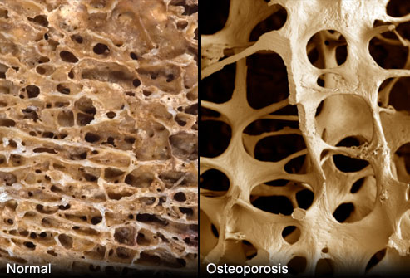
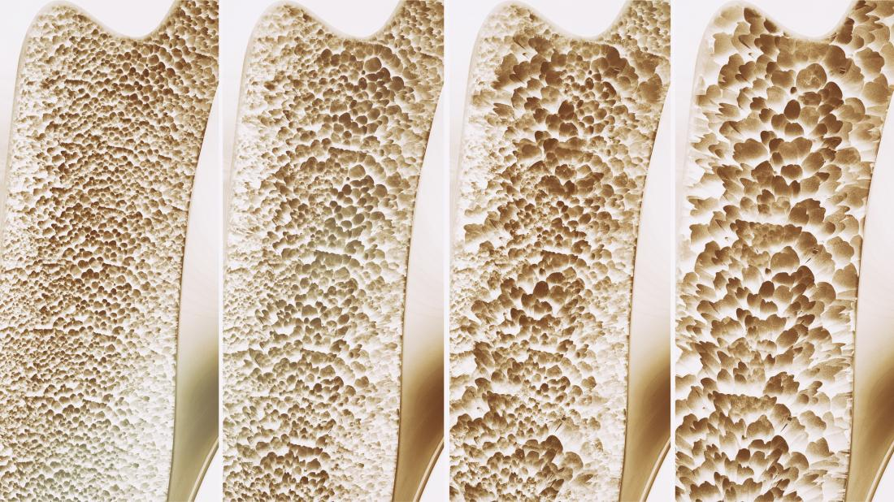
What is Osteoporosis?
the bones become quite fragile
holes in honeycomb become larger
lower overall density

Slide 3
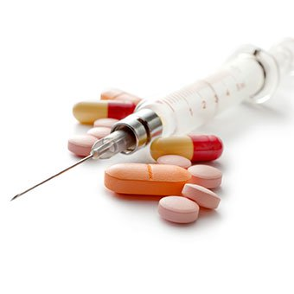
Causes
Steroids- affect the production of bone by lowering calcium in body
Intake for a long time will have effect on the body
Reduce absorption by intestine
Increase calcium loss by kidneys

Slide 4
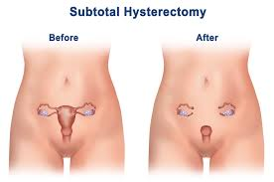
Causes
Lack of Estrogen- will speed up process of bone loss
Causes: early menopause, removing ovaries

Slide 5
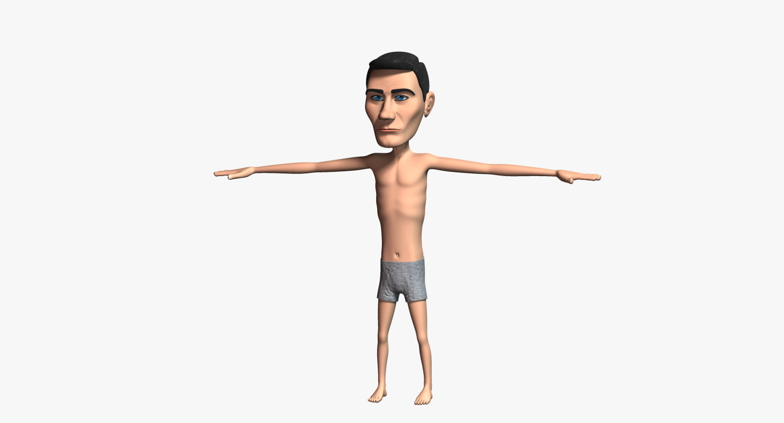
Causes
Lack of weight-bearing exercise- will have weaker bones, more likely to lose calcium
Exercise encourage bone development

Slide 6
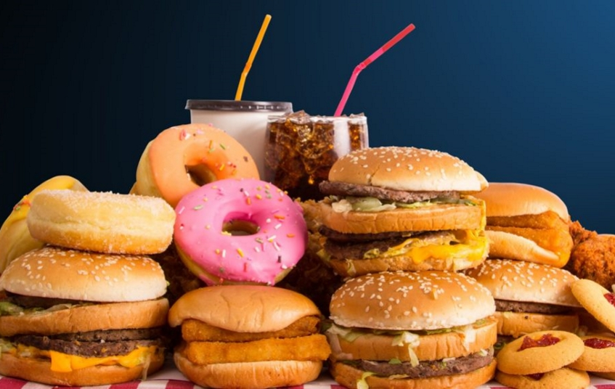
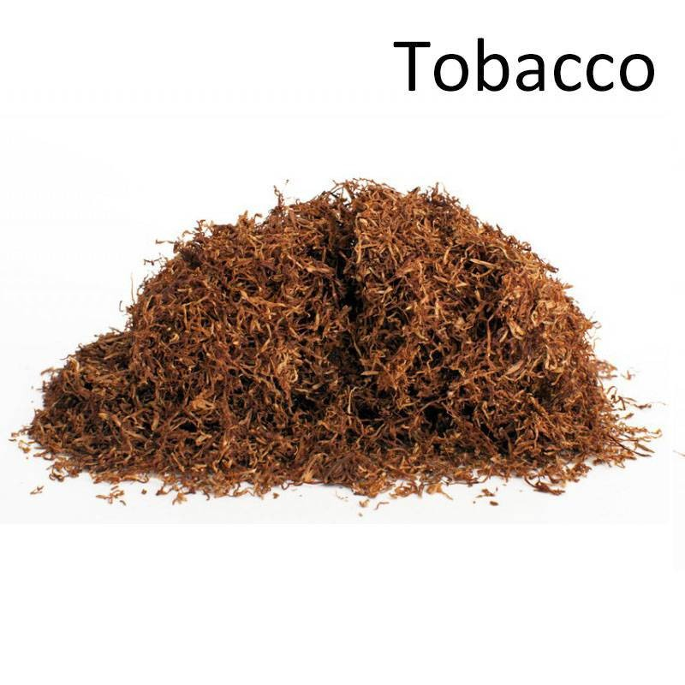
Causes
Poor diet
Not having enough Vitamin D or Calcium
Very underweight
Heavy smoking
Tobacco is toxic to bones
Can effect production of hormones (estrogen/testosterone)
Genetic
Can be inherited from parents

Slide 7
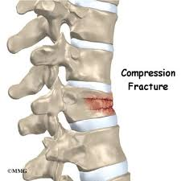
Symptoms
No clear symptoms
First sign: low-impact fracture
Most likely areas: hip, spine or wrist.
Back problems can effect height: vertebral crush fractures
Bones of the spine become compressed and fracture

Slide 8
Diagnosis
No clear signs
Check by DEXA (dual energy x-ray absorptiometry): measure the density of your bones
Normal
Osteopenia – Your bone is becoming weaker, low risk of low-impact fracture
Osteoporosis – high risk of low-impact fractures, you need treatment

Slide 9
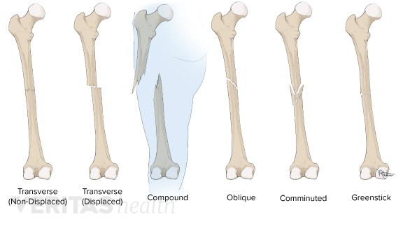
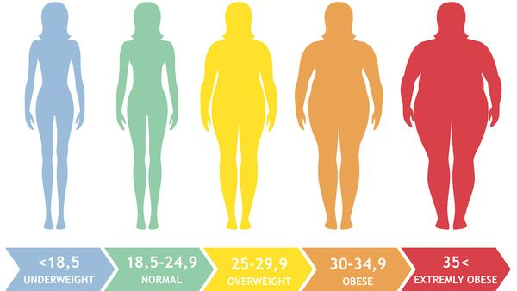
Diagnosis
Signs
already had a low-impact fracture
early menopause
your parents has had a hip fracture
body mass index (BMI) less than 19.

Slide 10
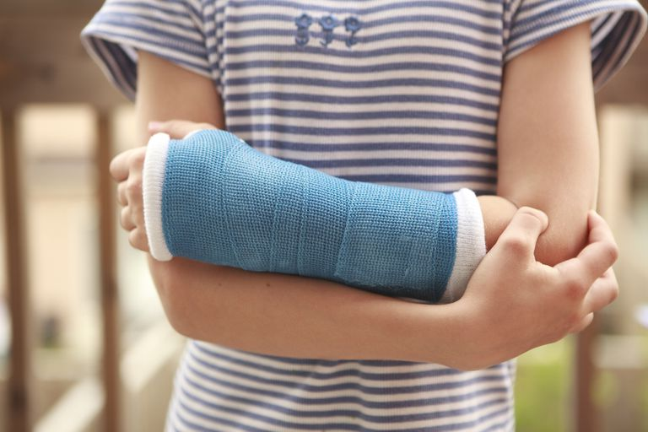
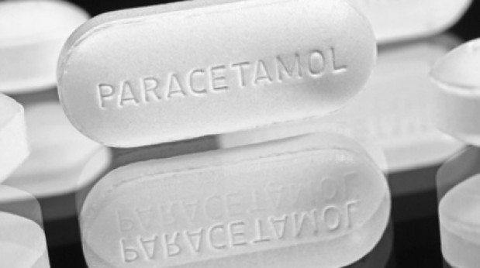
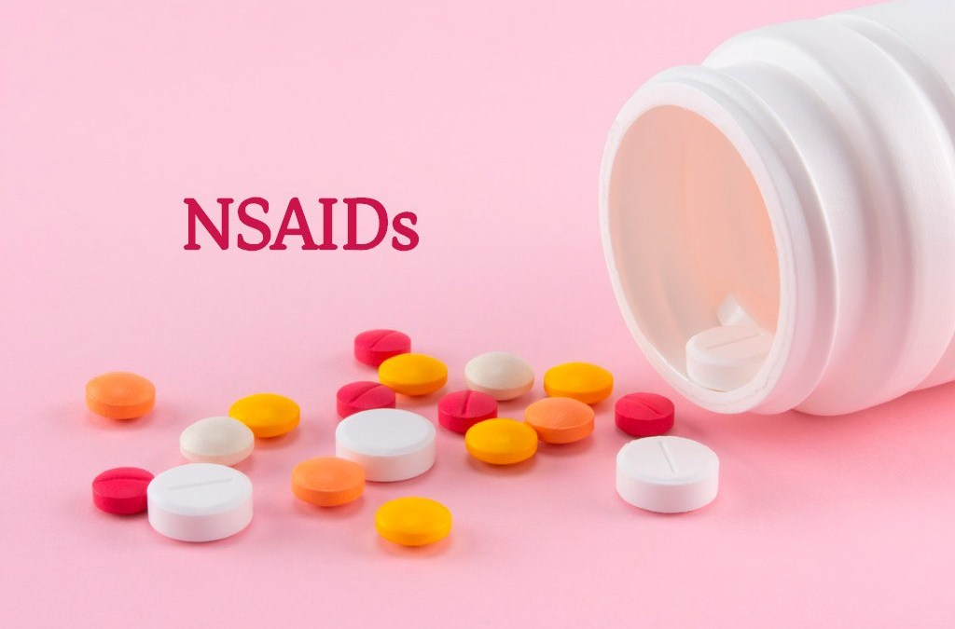
Treatment
Wear a cast to stop bones from moving
Likely to take pain relieving pills
Painkillers
Non-steroidal anti-inflammatory drugs (NSAIDs)

Slide 11
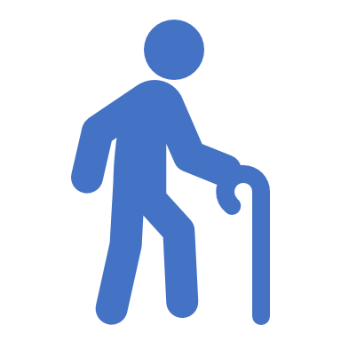
Why are old people more susceptible to osteoporosis?

Slide 12
Hormonal Changes
Women – menopause
Men – gradual decline of sex hormones

Slide 13
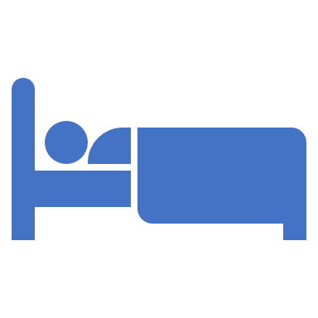
Inactive lifestyle

Slide 14
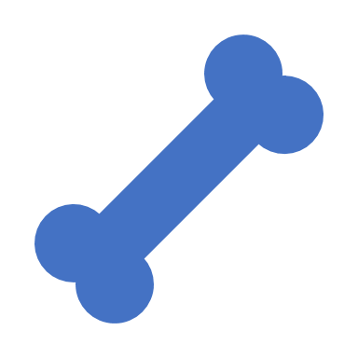
Loss of Calcium and Minerals

Slide 15
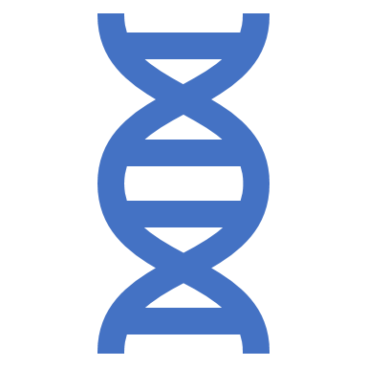
Genetics

Slide 16
Can children get osteoporosis too?

Slide 17
Secondary Osteoporosis
Medical conditions
e.g. osteogenesis imperfecta

Slide 18
Medication
Corticosteroids
Immunosuppressive Medications

Slide 19
Inactive lifestyle

Slide 20
How can we prevent osteoporosis?

Slide 21
Regular Exercise
Weight bearing exercises – leg and feet support weight
Resistance exercises – tendons pull on bone

Slide 22
Nutrition
Calcium – maintain strong bones
– from dairy and leafy greens
Vitamin D – helps body absorb Calcium
– mainly from sunlight

Slide 23
Did you know?
Fractures from osteoporosis are more common than heart attack, stroke and breast cancer combined.
Osteoporosis causes 70-90% of hip fractures annually.

Slide 24
Did you know?
14% of persons with a wrist fracture suffered a repeat fracture within 3 years.
50% hip fracture patients will suffer another fracture within 5 years.
The risk of suffering a second spine fracture within the first 12 months following an initial vertebral fracture is 20%

Slide 25
Did you know?
Women over the age of 50 are the most likely people to have osteoporosis.
Asian women are more likely to have osteoporosis than women of other ethnic background.

Slide 26
Age
Human bone density peaks around age of 30

Slide 27
Gender
Osteoporosis is 4 times likely to develop in women than in men.

Slide 28
Family History
If your parents or grandparents have had any signs of osteoporosis, you are more likely to get it too.

Slide 29
Bone structure
People that have small body frame are more likely to have osteoporosis.

Slide 30
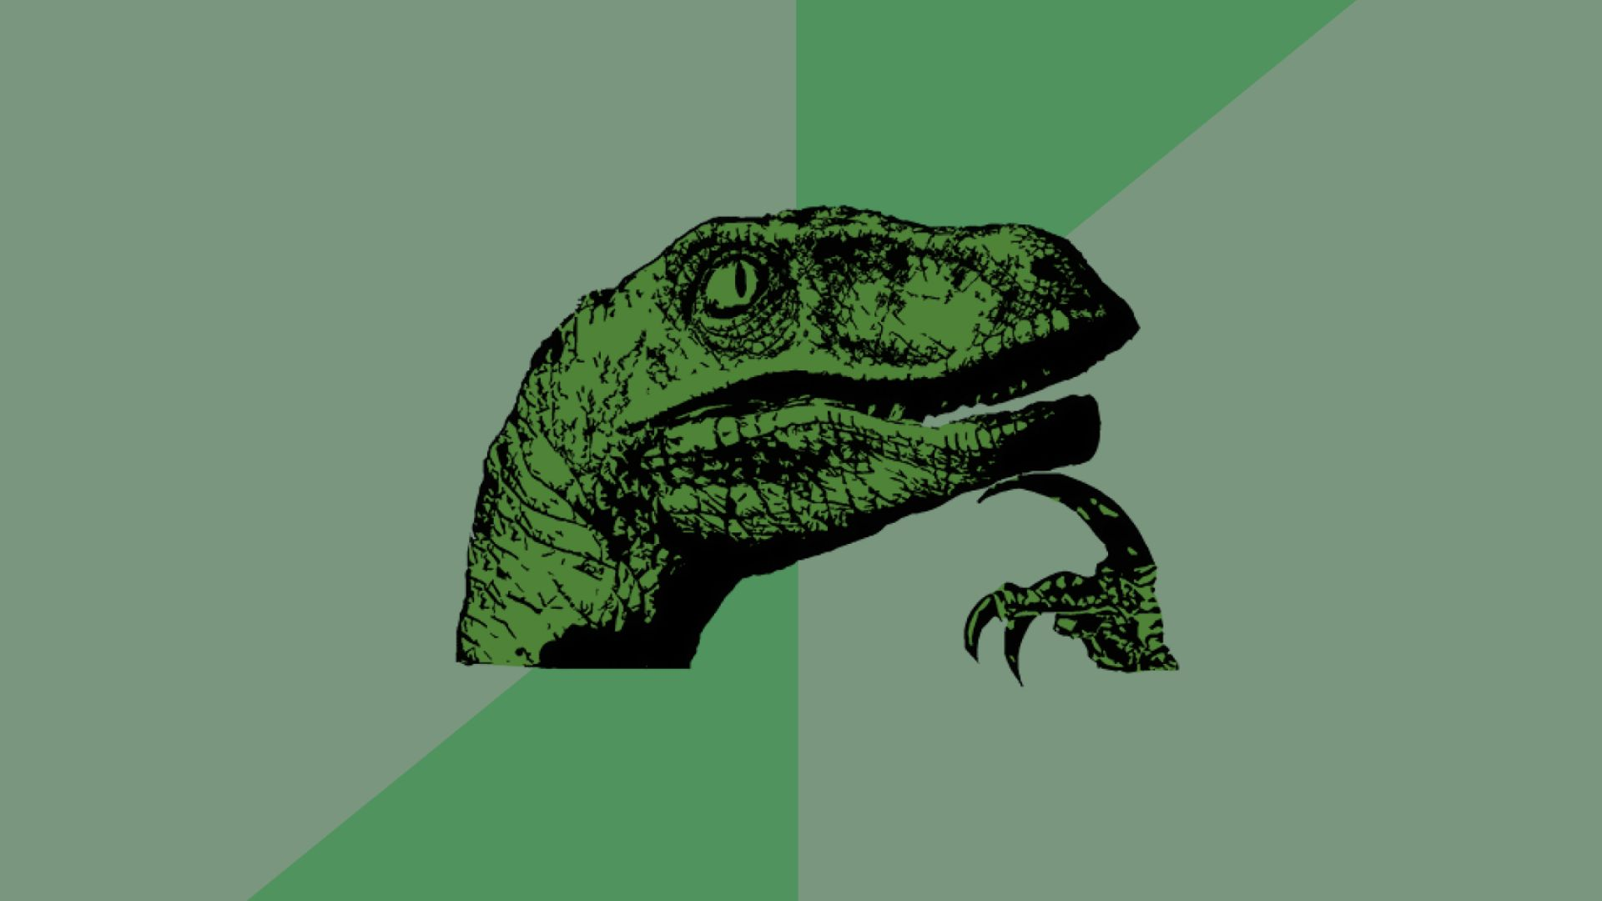
If you are an alcoholic, you are more likely to get osteoporosis.

Slide 31
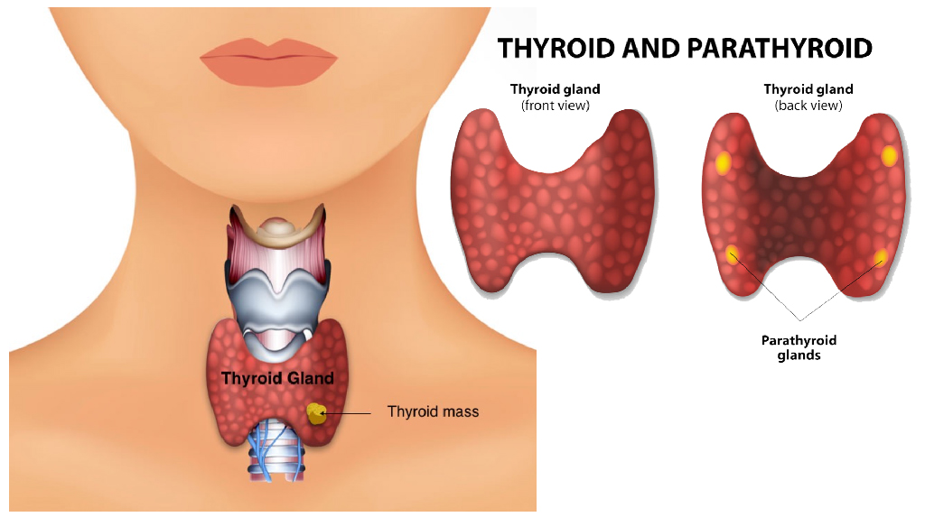
What are Parathyroid Glands?

Slide 32
What do they do?
They secrete a hormone called Parathyroid Hormone or Parathormone(PTH).

Slide 33
Parathyroid Hormone(PTH)
PTH increase the level of Calcium in your blood stream by destroying your bones in order to obtain Calcium.

Slide 34
References
https://www.versusarthritis.org/aboutarthritis/conditions/osteoporosis/
https://www.betterhealth.vic.gov.au/health/conditionsandtreatments/ageing-muscles-bones-and-joints
https://www.nhs.uk/conditions/osteoporosis/prevention/
http://theconversation.com/why-older-people-get-osteoporosis-and-have-falls-68145
https://www.chop.edu/conditions-diseases/juvenile-osteoporosis
https://osteoporosis.ca/about-the-disease/fast-facts/
https://www.webmd.com/osteoporosis/guide/osteoporosis-risk-factors\
https://www.webmd.com/osteoporosis/alcohol-and-osteoporosis#1

