Slide 1
Scurvy

Slide 2
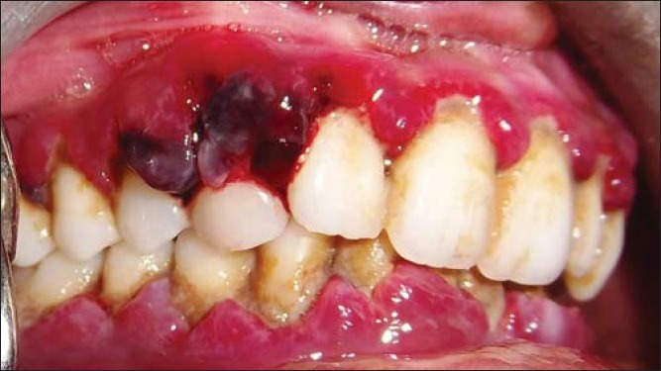
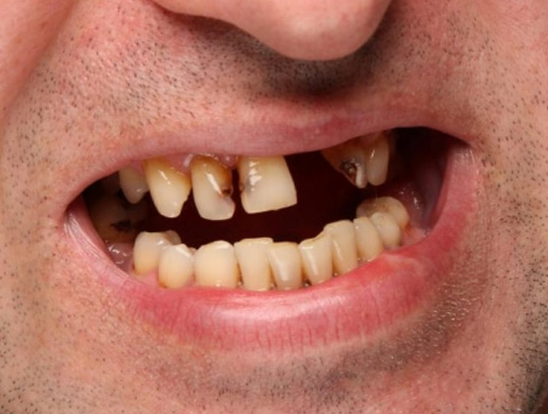
What is Scurvy?
Vitamin C deficiency”
Can lead to
Anemia
Debility
Exhaustion
Spontaneous bleeding
Pain in the limbs
Ulceration of the gums
Teeth loss

Slide 3
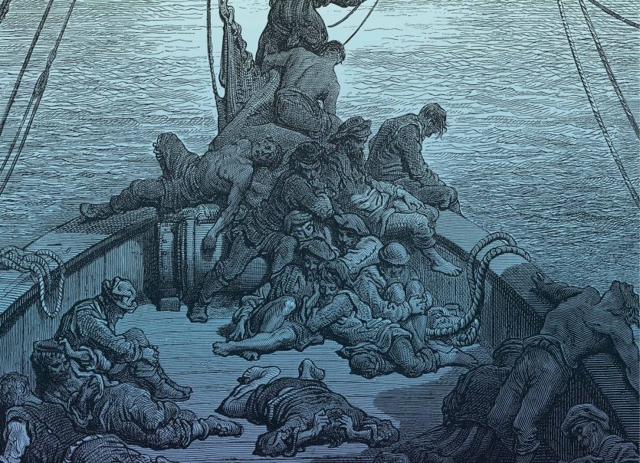
Scurvy History
Known since ancient Greek & Egyptian
Irish potato famine in 1845
American Civil War
Sailors in the 15th to 18th centuries
Lack of fresh produce when long sea voyages

Slide 4
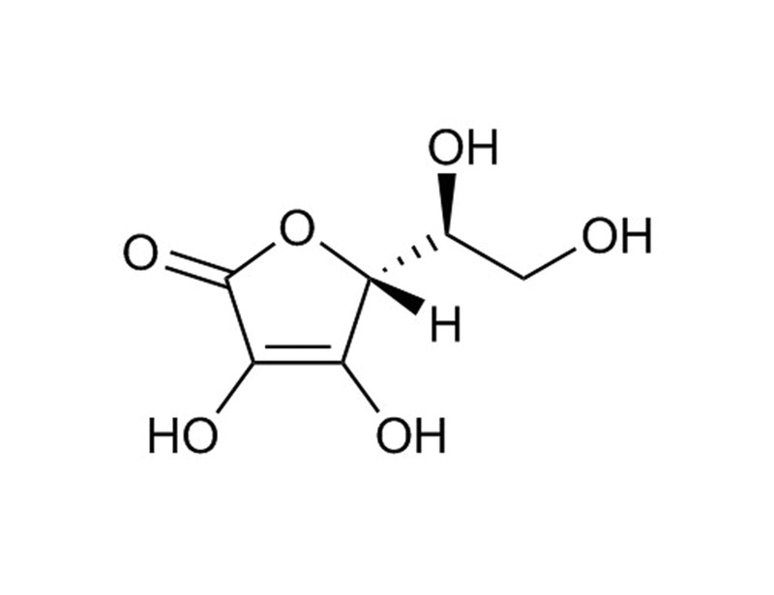
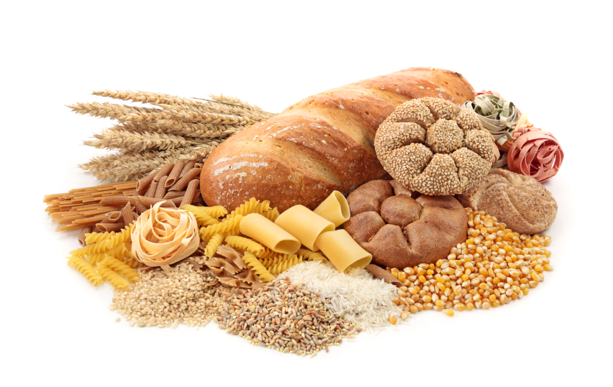
Causes
Lack of enriched breads & cereals
Lack Vitamin C/Ascorbic acid

Slide 5
Human behavior that cause scurvy
Poor diet
Anorexia (fear of gaining weight)
Older age
Alcohol / Illegal drugs

Slide 6
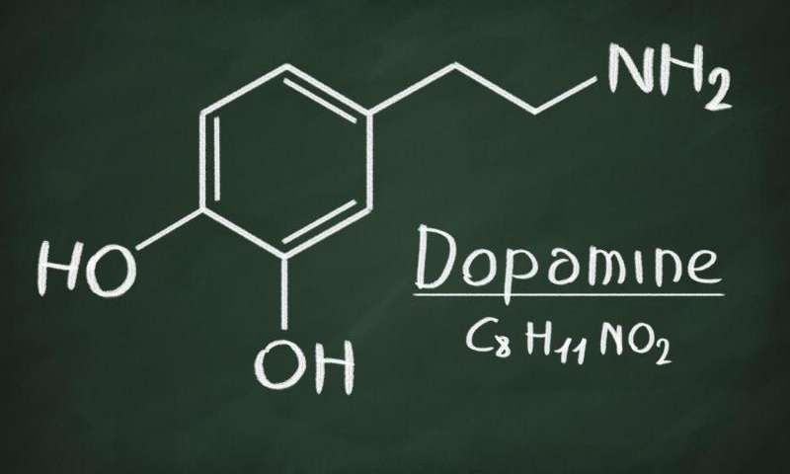
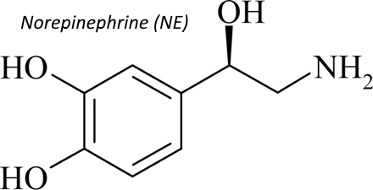
Vitamin C Functions
Absorb Iron
Produce Collagen
Energy production
Synthesizing
Dopamine
Norepinephrine
Epinephrine
Carnitine
Important component in connective tissues

Slide 7
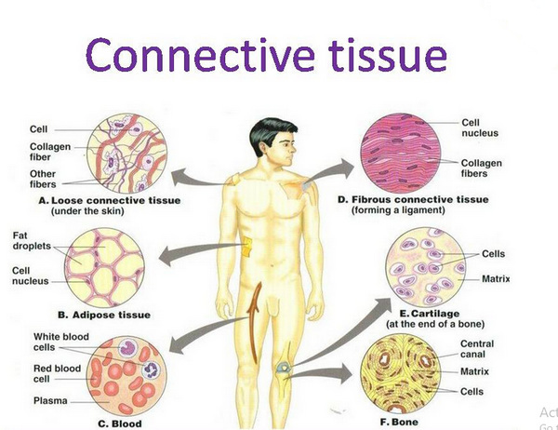
What Happen If Lack Of Vitamin C
Functions
Absorb Iron
Produce Collagen
Lack of Vitamin C will affect
Immune System
Absorption of iron
Metabolism of cholesterol
Important component in connective tissues
Process to maintain life

Slide 8
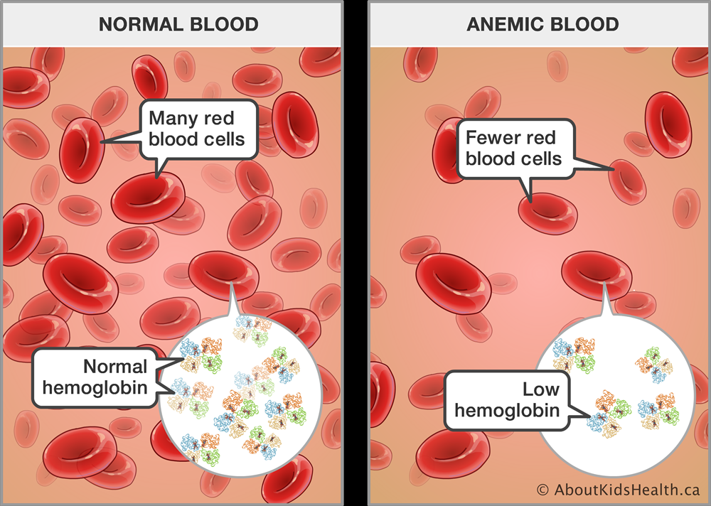
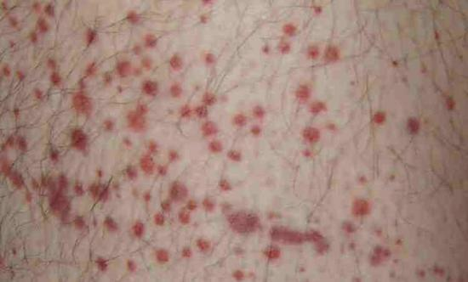
Symptoms Of Scurvy
Early signs
Loss of appetite
Weight loss,
Fatigue
Irritability
Lethargy
Within 1 to 3 months
Anemia
Gum disease
Loss teeth
Petechiae

Slide 9
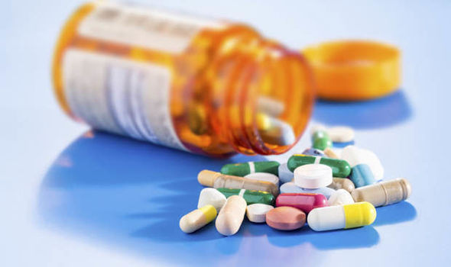
Treatment
Add Vitamin C by mouth / injection
1 to 2 grams (g) per day for 2 to 3 days
500 milligrams (mg) for the next 7 days
100 mg for 1 to 3 months
After 3 months, a complete recovery is possible

Slide 10
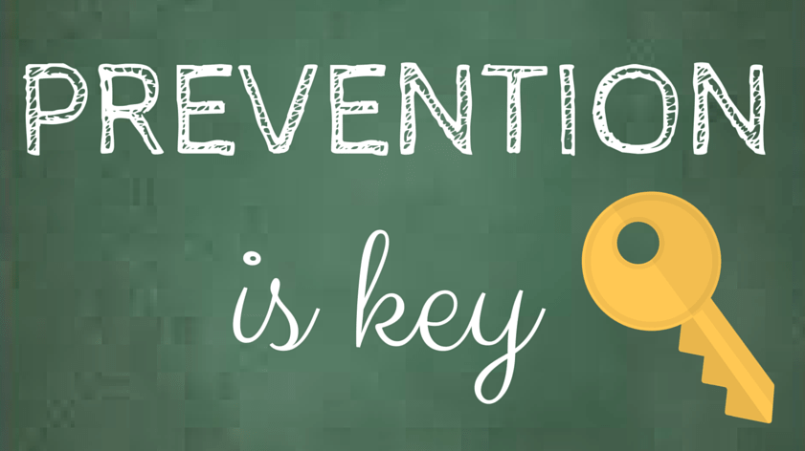
Prevention
Eat enough vitamin C
Up to 6 months: 40 mg, as normally supplied though breastfeeding
7 to 12 months: 50 mg
1 to 3 years: 15 mg
4 to 8 years: 25 mg
9 to 13 years: 45 mg
14 to 18 years: 75 mg for men and 65 mg for women
19 years and above: 90 mg for men, 75 mg and women

Slide 11
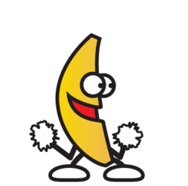
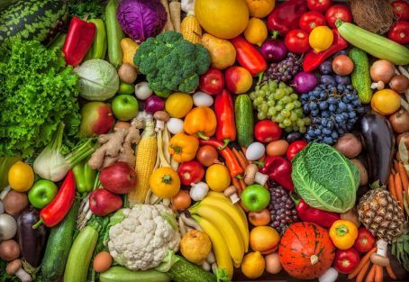
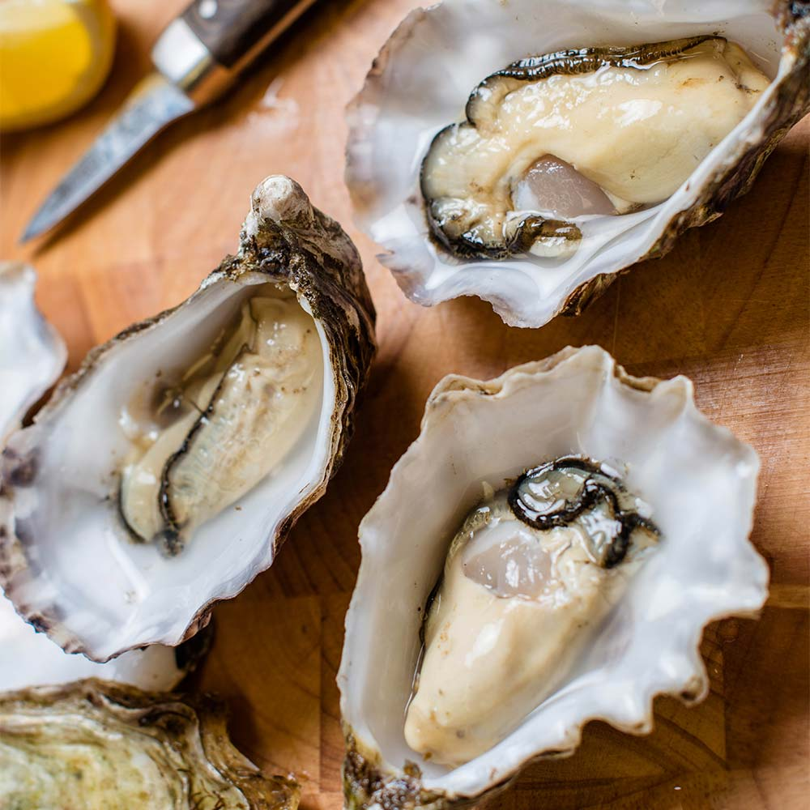
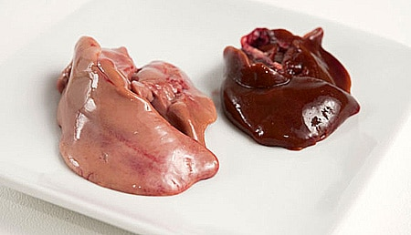
Foods That Contain Vitamin C
Vegetable & fruit
Paprika
Liver
Oysters

Slide 12
